Slide 1


Trento, 02 December 2020
Ph.D. Student: Chiara Nardin
chiara.nardin@unitn.it
Probabilistic
Seismic Hazard & Fragility Analysis
Hands-on: Matlab Tutorials
Ph.D. Student Chiara Nardin – M.Sc., Eng. in Civil Engineering
https://github.com/kia13nn/ISPS.git
Notes:
Good afternoon to everyone.
I’m Chiara Nardin, a civil engineer from the University of Trento, involved in a Ph.D. programme entitled Risk analysis of industrial plants based on Markov's processes.
Today, in these 2-hours lectures, we will discuss about PSHA and fragility analysis: by applying notions we are going to unfold to some already prepared MATLAB tutorials.
Before starting, all the materials presented are uploaded and hopefully updated on the GitHub link here below. Please do not hesitate to fork or to download and feel free to contact me for any issues.

Slide 2
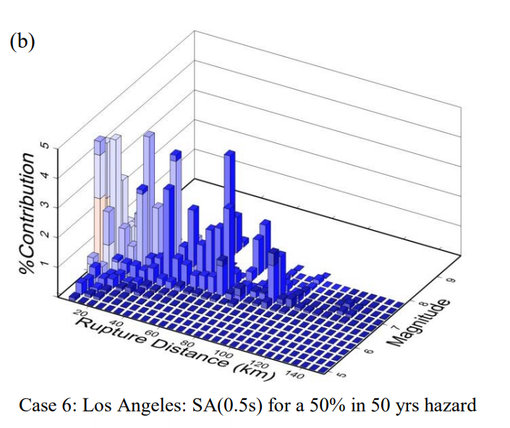
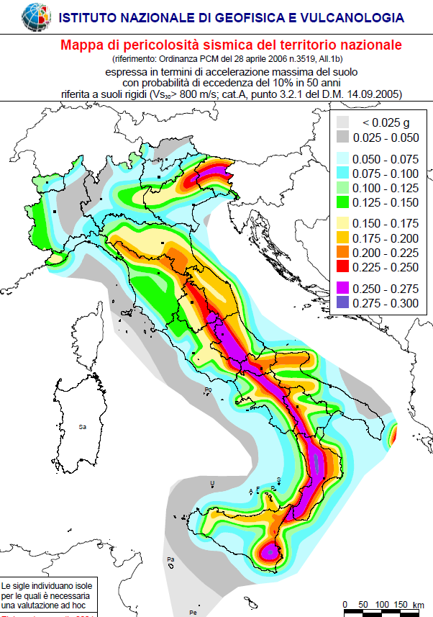
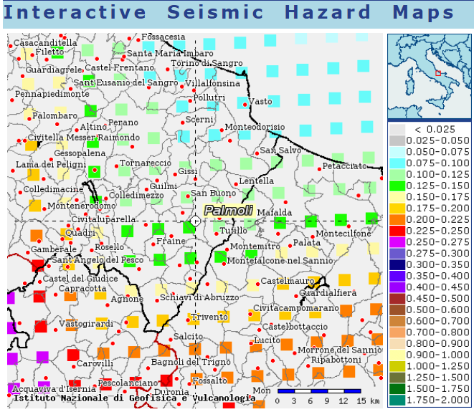
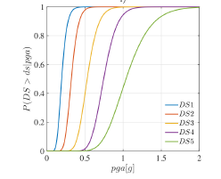
Trento, 02 December 2020
Ph.D. Student: Chiara Nardin
chiara.nardin@unitn.it
Introduction | Probabilistic Hazard Analysis | Fragility Analysis | References
Course outline:
Introduction
PBEE overview
the PEER-PBEE framework
Probabilistic Seismic Hazard Model
Concept and Formulation
Hazard Computation (MatLab)
Vulnerability and Fragility Analysis
Concept and Formulation
Fragility Computation (MatLab)
References
http://zonesismiche.mi.ingv.it/
Notes:
Here is presented the course outline.
First, a brief introduction on PBEE and especially on the proposed framework of the PEER, i.e. Pacific Earthquake Research Center of Berkeley, here adopted.
Then, Probabilistic seismic hazard model is presented: starting from main concepts and analytical formulations to an implementation on MATLAB and a comparison of results with the ones provided by the Italian National Institute INGV {AINGVI}.
In the second hour, we will unfold main ideas on fragility concepts and discuss a case study implemented on MATLAB in order to perform fragility curves.
Finally, some references are provided.

Slide 3
Trento, 02 December 2020
Ph.D. Student: Chiara Nardin
chiara.nardin@unitn.it
Introduction
Performance Based Earthquake Engineering
Ph.D. Student Chiara Nardin – M.Sc., Eng. in Civil Engineering
https://github.com/kia13nn/ISPS.git

Slide 4
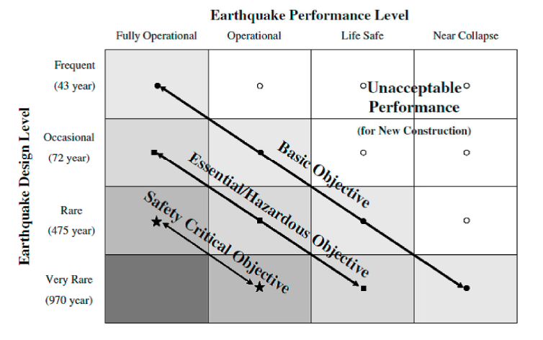
Trento, 02 December 2020
Ph.D. Student: Chiara Nardin
chiara.nardin@unitn.it
Introduction | Probabilistic Hazard Analysis | Fragility Analysis | References
PBEE: Performance Based Earthquake Engineering
Probabilistic framework for (i) assessing design, (ii) evaluation and (iii) planning of civil system.
load-and-resistence-factor design (LRFD)
performance based design (PBD):
3Ds – i.e. downtime, dollars, death
2 axes define the domain of acceptable system’s response:
System performance objectives
Seismic hazard level, w.r.t. return periods
Fig.1 – PBEE concept: seismic performance objectives vs seismic hazard level. ©Poland et al.,(1995)-Vision 2000: Performance Based Earthquake Engineering of buildings. Structural Engineers Association of California, Sacramento, CA.
Notes:
Let’s start with PBEE.
Performance-Based Earthquake Engineering (PBEE) is a probabilistic framework, which supports designers and stakeholders in assessing design, evaluation, and planning of civil systems. The utmost goal of the PBEE is to replace the classical load-and-resistance-factor design, based on evaluation of failure probabilities of single components, by developing instead a framework capable of assessing performances of a system, with respect to different decision variables such as downtime, monetary losses and fatalities.
A schematic view of the PBEE framework is given in Figure 1.
Two axes define the PBEE framework, a discrete set of system performance objectives, that includes for example fully operational, operational, life safe and near collapse, and a set (discrete or continuous) of seismic hazard level, divided according to return period or exceedance probability.
The generated domain is therefore partitioned into an acceptable and not acceptable subdomain: here, in the former, designer and stakeholders identify the desired or optimal combination between performance objectives and hazard level in order to evaluate, according to its likelihood, the monetary cost of the system.

Slide 5
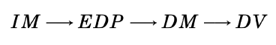
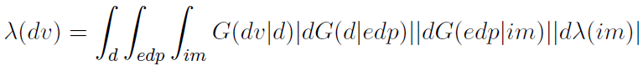

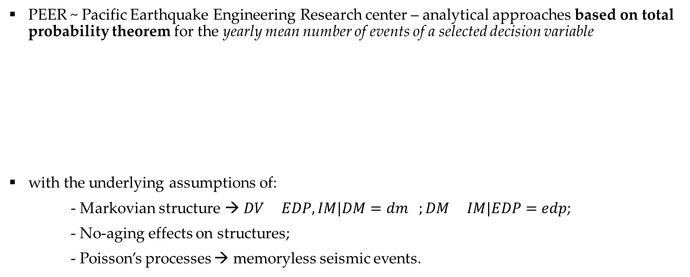
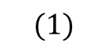
Trento, 02 December 2020
Ph.D. Student: Chiara Nardin
chiara.nardin@unitn.it
Introduction | Probabilistic Hazard Analysis | Fragility Analysis | References
The PEER-PBEE Framework
PEER ~ Pacific Earthquake Engineering Research center – analytical approaches based on total probability theorem for the yearly mean number of events of a selected decision variable
with the underlying assumptions of:
- Markovian structure → $DV EDP,IM|DM=dm ;DM IM|EDP=edp$;
- No-aging effects on structures;
- Poisson’s processes → memoryless seismic events.
$$(1)$$
Notes:
There are several alternatives and approaches to PBEE; anyway, in this class, we focus on the one provided by PEER.
The framework is simply a statement of the total probability theorem for the yearly mean number of events of a selected decision variable. You can see its analytical expression in Eq.(1): the so-called famous triple integral of PEER.
The underlying assumptions are here briefly reported and are basically: i) markovian structure, i.e. each of the conditional probabilities we are going to see can be read as statistical independent from the previous terms; ii) no aging effects are considered in the structure; iii) seismic events as a poissonian processes.

Slide 6
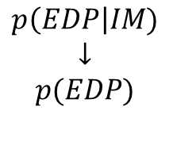
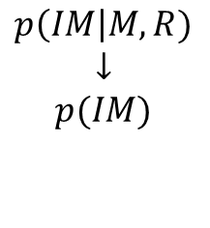
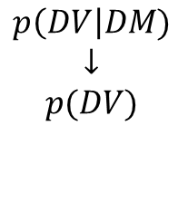
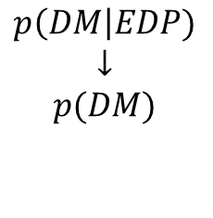
Trento, 02 December 2020
Ph.D. Student: Chiara Nardin
chiara.nardin@unitn.it
Introduction | Probabilistic Hazard Analysis | Fragility Analysis | References
The PEER-PBEE Framework
Hazard analysis
intensity measure
Loss analysis
decision variable
HAZARD
VULNERABILITY
Damage analysis
damage measure
DECISION MAKING
VULNERABILITY
Vulnerability analysis
engineering demand par.
(i) hazard analysis
(ii) fragility analysis
(iii) damage analysis
(iv) loss analysis
$$p\left(IM\right|M,R)$$
$$↓$$
$$p(IM)$$
$$p\left(EDP\right|IM)$$
$$↓$$
$$p(EDP)$$
$$p\left(DM\right|EDP)$$
$$↓$$
$$p(DM)$$
$$p\left(DV\right|DM)$$
$$↓$$
$$p(DV)$$
Notes:
However, what is more important to understand reguards the structure of this formulation.
In fact, Eq. (1) is build on four distinct stages that can be considered and evaluated alone.
The first stage/step reguards
hazard analysis which evaluates the mean annual rate of exceedance of the IM, at the facility site.
structural/fragility analysis: the engineer creates a structural model of the system, where the input is derived from the hazard analysis and the output is computed via structural analysis.
damage analysis: evaluates the relationship between EDP(i.e. the output of fragility analysis) and DM damage measure
loss analysis: (the yellow one) decision variable measures the seismic performance of the facility in terms of the stakeholder interest

Slide 7
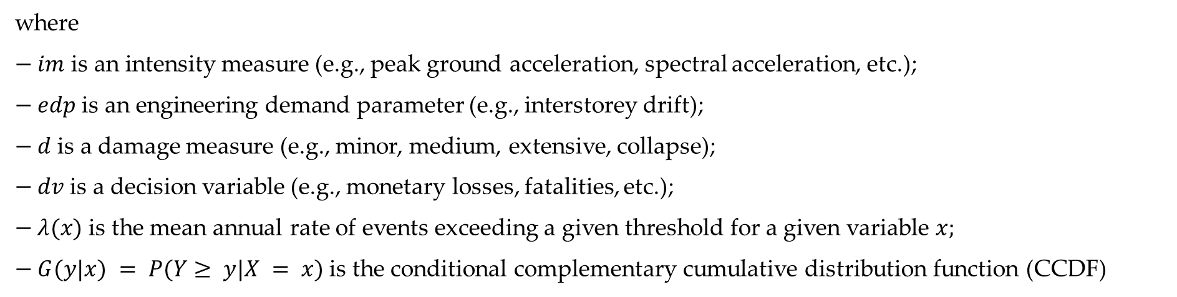
Trento, 02 December 2020
Ph.D. Student: Chiara Nardin
chiara.nardin@unitn.it
Introduction | Probabilistic Hazard Analysis | Fragility Analysis | References
The PEER-PBEE Framework
where
$− im$ is an intensity measure (e.g., peak ground acceleration, spectral acceleration, etc.);
$− edp$ is an engineering demand parameter (e.g., interstorey drift);
$− d$ is a damage measure (e.g., minor, medium, extensive, collapse);
$− dv$ is a decision variable (e.g., monetary losses, fatalities, etc.);
$− λ(x)$ is the mean annual rate of events exceeding a given threshold for a given variable $x;$
$− G(y|x) = P(Y≥ y|X = x)$ is the conditional complementary cumulative distribution function (CCDF)
Notes:
Here’s who is who. But what is again more important to understand is that Each arrow represents a model. For example, a simulation model provides the EDP for a given IM,
and a damage model provides the DM for a given EDP. Independence is assumed for quantities
that are not directly linked by a model. For instance, given the EDP, the DM are assumed to be
independent of the IM.

Slide 8
Trento, 02 December 2020
Ph.D. Student: Chiara Nardin
chiara.nardin@unitn.it
Probabilistic Hazard Analysis
Formulation and MatLab Computation
Ph.D. Student Chiara Nardin – M.Sc., Eng. in Civil Engineering
Notes:
So, the first step of PBEE is SHA, that represent the basis for many earthquake design codes practices and for seismic risk analysis of civil systems. Reliable estimates of a seismic hazard are paramounts to minimize loss of life, property damage and social and economic disruption.

Slide 9
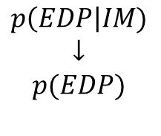
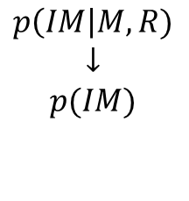
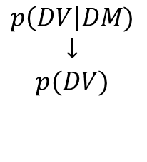
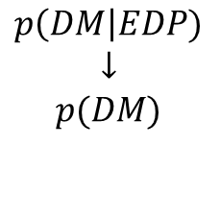
Trento, 02 December 2020
Ph.D. Student: Chiara Nardin
chiara.nardin@unitn.it
Introduction | Probabilistic Hazard Analysis | Fragility Analysis | References
Seismic Hazard Analysis
Hazard analysis
intensity measure
Loss analysis
decision variable
HAZARD
VULNERABILITY
Damage analysis
damage measure
DECISION MAKING
VULNERABILITY
Vulnerability analysis
engineering demand par.
SHA is the basis for many earthquake design codes and for seismic risk analysis of civil systems.
Useful definitions:
seismic hazard := the exceedance (or occurrence) probability for a given ground motion intensity measure threshold, site and time interval
seismic risk:= the exceedance (or occurrence) probability for a given loss threshold, site and time interval.
$$p\left(IM\right|M,R)$$
$$↓$$
$$p(IM)$$
$$p\left(EDP\right|IM)$$
$$↓$$
$$p(EDP)$$
$$p\left(DM\right|EDP)$$
$$↓$$
$$p(DM)$$
$$p\left(DV\right|DM)$$
$$↓$$
$$p(DV)$$
Notes:
So, the first step of PBEE is SHA, that represent the basis for many earthquake design codes practices and for seismic risk analysis of civil systems. Reliable estimates of a seismic hazard are paramounts to minimize loss of life, property damage and social and economic disruption.

Slide 10
Trento, 02 December 2020
Ph.D. Student: Chiara Nardin
chiara.nardin@unitn.it
Introduction | Probabilistic Hazard Analysis | Fragility Analysis | References
DSHA
Evaluate the worst-case scenario
PSHA
Evaluate the exceedance probability of a given g.m. IM threshold at given site and time interval
Seismic Hazard Analysis – DSHA vs PSHA
Four steps of a DSHA and PSHA analyses - Kramer, 1996
Notes:
The approaches to seismic hazard assessment can be grouped into two broad categories: deterministic
and probabilistic.
A Deterministic Seismic Hazard Analysis (DSHA) consists in the analysis of a particular seismic
scenario. Generally, the output of the analysis is the intensity level of the selected hazard
scenario. In particular, the scenario consists of the postulated occurrence of an earthquake of a
specific size occurring at a given location. So, the DSHA provides a straightforward framework for the evaluation of the worst-case ground motions. This is a useful procedure when applied to critical facilities (e.g. nuclear power plant), where failure could have catastrophic efiects. However, it does not provide any information regarding the likelihood of occurrence of the controlling earthquakes.
Probabilistic seismic hazard analysis instead (PSHA) provides an uncertainty quantification framework
to address the hazard analysis.
Here we will focus our attention on this probabilistic approach.

Slide 11
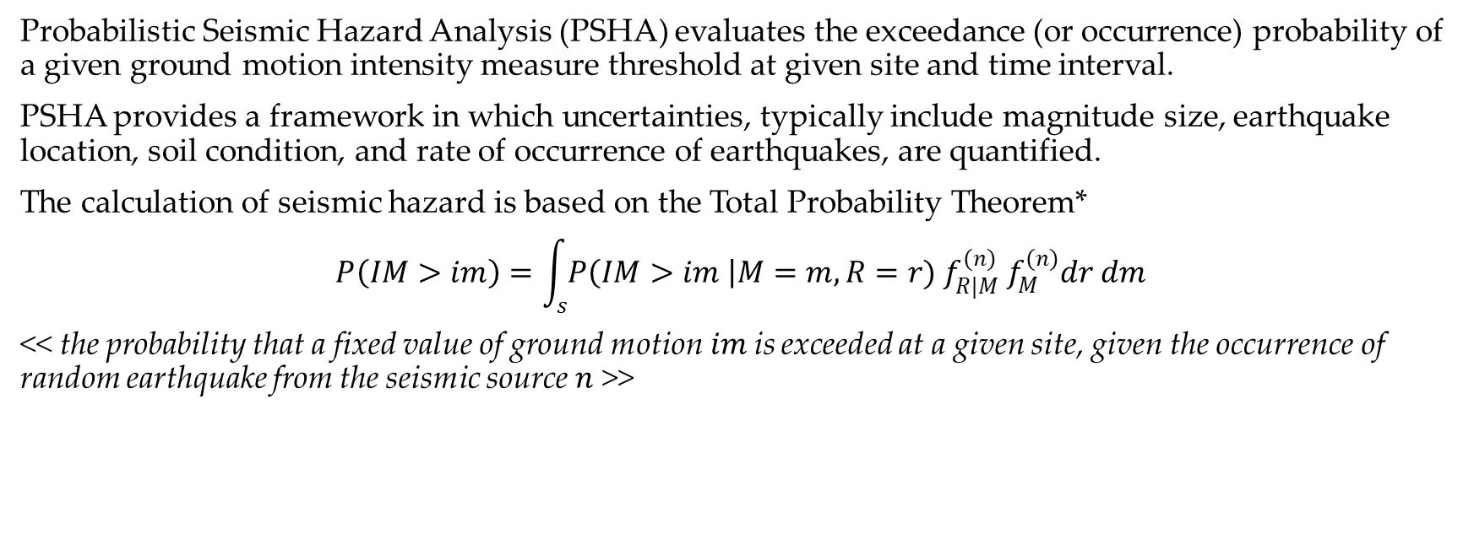
Trento, 02 December 2020
Ph.D. Student: Chiara Nardin
chiara.nardin@unitn.it
Introduction | Probabilistic Hazard Analysis | Fragility Analysis | References
PSHA
Probabilistic Seismic Hazard Analysis (PSHA) evaluates the exceedance (or occurrence) probability of a given ground motion intensity measure threshold at given site and time interval.
PSHA provides a framework in which uncertainties, typically include magnitude size, earthquake location, soil condition, and rate of occurrence of earthquakes, are quantified.
The calculation of seismic hazard is based on the Total Probability Theorem*
$$P\left(IM>im\right)=\int_{s}{P\left(IM>im \right|M=m, R=r){ f}_{R|M}^{(n)} f_{M}^{(n)}dr dm}$$
<< the probability that a fixed value of ground motion$im$is exceeded at a given site, given the occurrence of random earthquake from the seismic source $n$ >>
(1)
*see Notes at the end of Presentation
Notes:
The goal of a PSHA is to evaluate the exceedance (or occurrence) probability of a given ground motion
intensity measure threshold at a considered site and in a considered time interval. These intensity
measures are then related to facilities damages, economic and social losses.
PSHA provides a framework in which uncertainties are quantified, and combined in a rational manner to provide a comprehensive description of the seismic hazard. These uncertainties typically include magnitude size, earthquake location, soil condition, and rate of occurrence of earthquakes.
In detail, the calculation of seismic hazard is based on the Total Probability Theorem as reported in eq. (1)
The (1) expresses the probability that a fixed value of ground motion im is exceeded at a given site, given
the occurrence of random earthquake from the seismic source n.

Slide 12
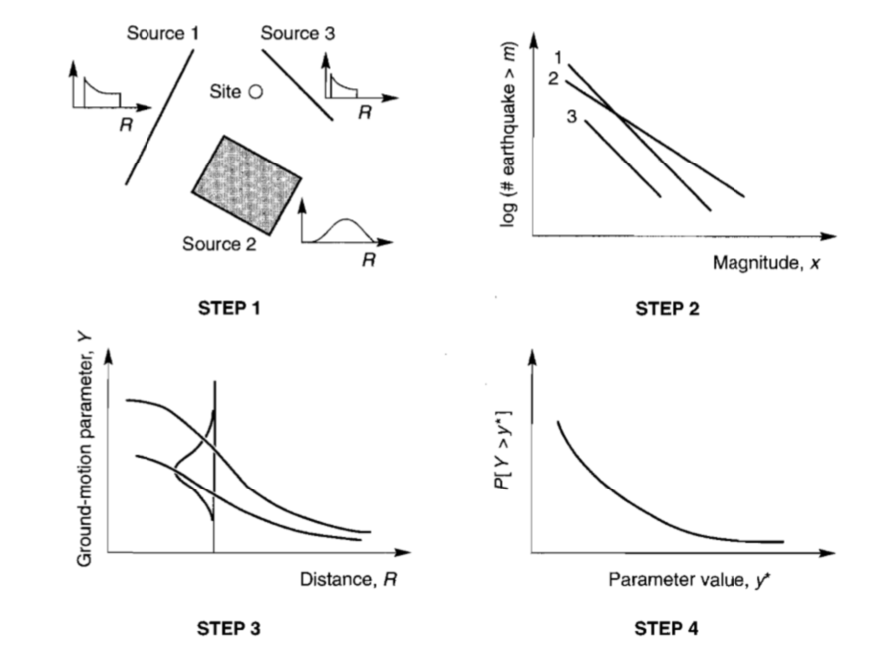
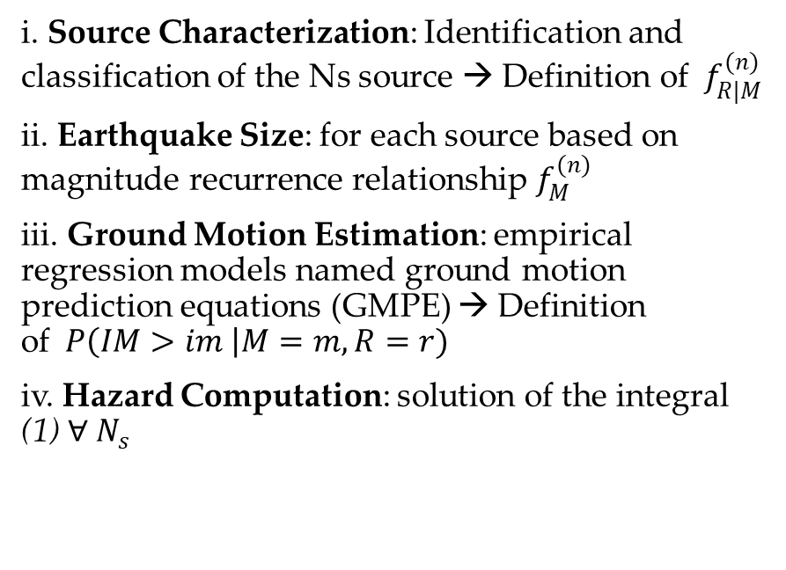
Trento, 02 December 2020
Ph.D. Student: Chiara Nardin
chiara.nardin@unitn.it
Introduction | Probabilistic Hazard Analysis | Fragility Analysis | References
PSHA - Steps
i. Source Characterization: Identification and classification of the Ns source → Definition of ${ f}_{R|M}^{(n)}$
ii. Earthquake Size: for each source based on magnitude recurrence relationship $f_{M}^{(n)}$
iii. Ground Motion Estimation: empirical regression models named ground motion prediction equations (GMPE) → Definition of$P\left(IM>im \right|M=m, R=r)$
iv. Hazard Computation: solution of the integral (1) $∀ N_{s}$
Notes:
The general procedure to perform PSHA is outlined by Cornell (1968) and it is based on four main steps:
source characterization: Identification and classification of the Ns sources. Each
source can be represented as area source, fault source, or, rarely, point sources, depending upon the geological nature of the sources and available data
earthquake size: Definition of $f_{M}^{m}$ the PDF magnitude for each source n, based onthe magnitude recurrence relationship or law, i.e. for example the Gutenberg-Richter one;
Ground motion estimation. Definition of P(IM > im|M = m;R = r). conditional probabilities, or For a given
magnitude and distance the definition of the probability of exceedance of a given intensity measure level
im.
Hazard computation. Solution of the the triple integral for all the Ns sources.

Slide 13
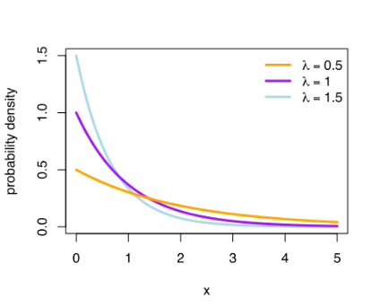
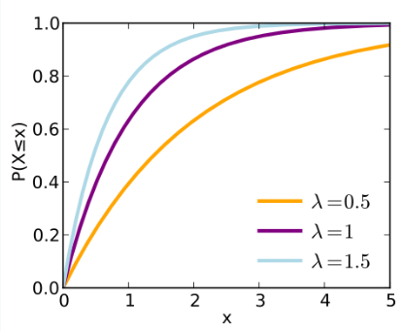
Trento, 02 December 2020
Ph.D. Student: Chiara Nardin
chiara.nardin@unitn.it
Introduction | Probabilistic Hazard Analysis | Fragility Analysis | References
PSHA – Assumptions:
Eq. (1) is based on the following assumptions:
Earthquakes form a stochastic process;
Earthquakes can be considered instantaneous events and memory-less
the occurrence of earthquakes can be defined as Homogeneus Poisson Process (HPP)
PDF
CDF
exponential distribution of earthquake recurrence
Notes:
So, here the main assumptions underlying PSHA are remarked:
Earthquakes consists in a stochastic process; and can be considered instantaneous and memoryless events
These let us make a reasonable assumption in define the occurrence of ground motions as homogeneus poisson process and that means that the equation describing the recurrence distribution is an exponential one, as depicted aside.

Slide 14
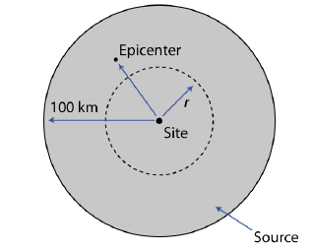
Trento, 02 December 2020
Ph.D. Student: Chiara Nardin
chiara.nardin@unitn.it
Introduction | Probabilistic Hazard Analysis | Fragility Analysis | References
PSHA – Step 1: Earthquake source characterization
Goal: to identify
Fault sources: individual or multiple identified faults
Area sources: defined by polygons in which seismicity is assumed uniform
(Identification based upon the interpretation of geological, geophysical and seismological – historical data)
and to characterize seismic sources
Point source
Linear source
Area source
(the geometry of the source is used to identify the probability distribution of source-to-site distances)
SOURCES
DISTANCES
Notes:
Let’s enter in the detailed steps of the PSHA.
The first goal is to identify the nature of the sources: that could be fault both individual or multiple, but also area sources define by polygons in which seismicity is assumed uniform. The identification is based upon the interpretation of geological and seismological data. So, identify but also characterize the seismic source in terms also of distances, or in other term to characterize the geometry of the source so that is possible to identify the probability distribution of source-to-site distances.

Slide 15
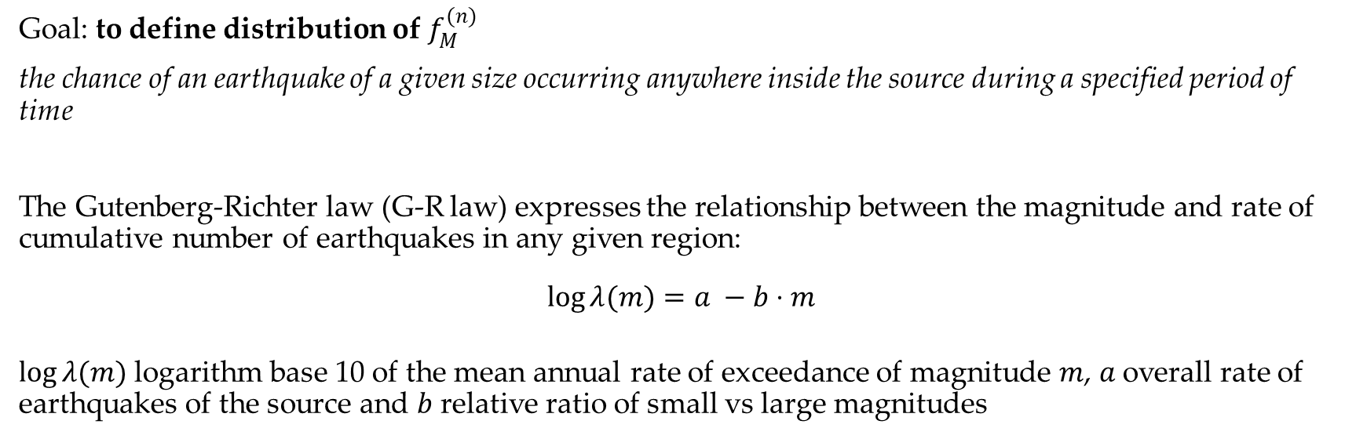
Trento, 02 December 2020
Ph.D. Student: Chiara Nardin
chiara.nardin@unitn.it
Introduction | Probabilistic Hazard Analysis | Fragility Analysis | References
PSHA – Step 2: Earthquake size (Recurrence law)
Goal: to define distribution of $f_{M}^{(n)}$
the chance of an earthquake of a given size occurring anywhere inside the source during a specified period of time
The Gutenberg-Richter law (G-R law) expresses the relationship between the magnitude and rate of cumulative number of earthquakes in any given region:
$$\log{λ(m)}=a −b⋅m$$
$\log{λ(m)}$logarithm base 10 of the mean annual rate of exceedance of magnitude $m$, $a$overall rate of earthquakes of the source and $b$ relative ratio of small vs large magnitudes
Notes:
Once the source characterization is completed, we define the distribution of the fM(m). This is usually
based on a recurrence model describing “the chance of an earthquake of a given size occurring anywhere
inside the source during a specified period of time”.
In many applications the exponential probability distribution is used to represent the relative frequency
of different earthquake magnitudes(McGuire, 2004). In particular, the most used recurrence law model is
the one proposed by Gutenberg and Richter (1954). The Gutenberg-Richter law (G-R law) expresses the
relationship between the magnitude and rate of cumulative number of earthquakes in any given region.
where log is the logarithm base 10, _(m) is the mean annual rate of exceedance of magnitude m, and a
and b are constants. The a value indicates the overall rate of earthquakes of the source, and the b value
indicates the relative ratio of small and large magnitudes ( a typical value of b is 1).

Slide 16
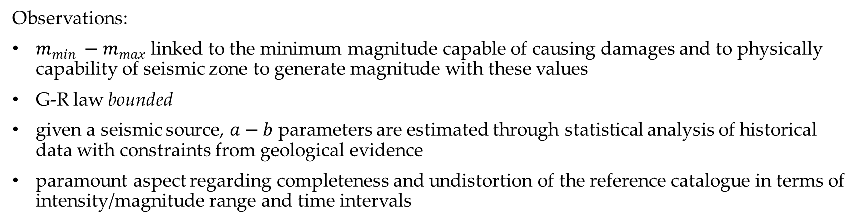
Trento, 02 December 2020
Ph.D. Student: Chiara Nardin
chiara.nardin@unitn.it
Introduction | Probabilistic Hazard Analysis | Fragility Analysis | References
PSHA – Step 2: Earthquake size (Recurrence law)
Observations:
$m_{min} −m_{max}$ linked to the minimum magnitude capable of causing damages and to physically capability of seismic zone to generate magnitude with these values
G-R law bounded
given a seismic source, $a−b$ parameters are estimated through statistical analysis of historical data with constraints from geological evidence
paramount aspect regarding completeness and undistortion of the reference catalogue in terms of intensity/magnitude range and time intervals
Notes:
Some observations are needed. The general formulation of the G-R law covers an ideally infinite range of magnitudes, but often a lower and an upper-bound, mmin and mmax respectively, are used resulting in a truncated exponential distribution for magnitude frequency, named bounded G-R law (14).
The minimum magnitude is generally linked to the minimum magnitude which is believed to produce
damages to the structures. It is usually set at values from about 4.0 to 5.0.The truncation at mmax may arise because the magnitude scale saturates or better because the seismic zone cannot physically generate magnitudes above this value.
Then another point, regards the constants a and b that are usually estimated using statistical analysis of historical data (preinstrumental and instrumental seismicity) with additional constraining data provided by geological evidence.
Finally Another important aspect to consider for the estimation of the G-R parameters are the completeness and undistortion of the seismic catalogue in terms of intensity/magnitude and time intervals in which a certain
intensity/magnitude range is likely to be completely reported.

Slide 17
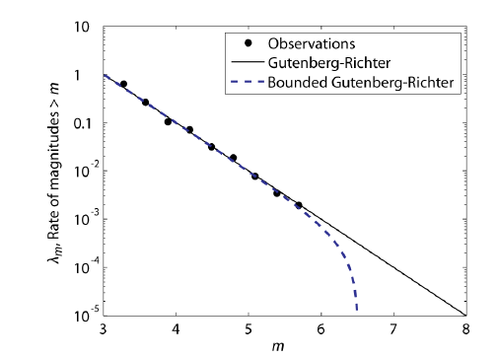
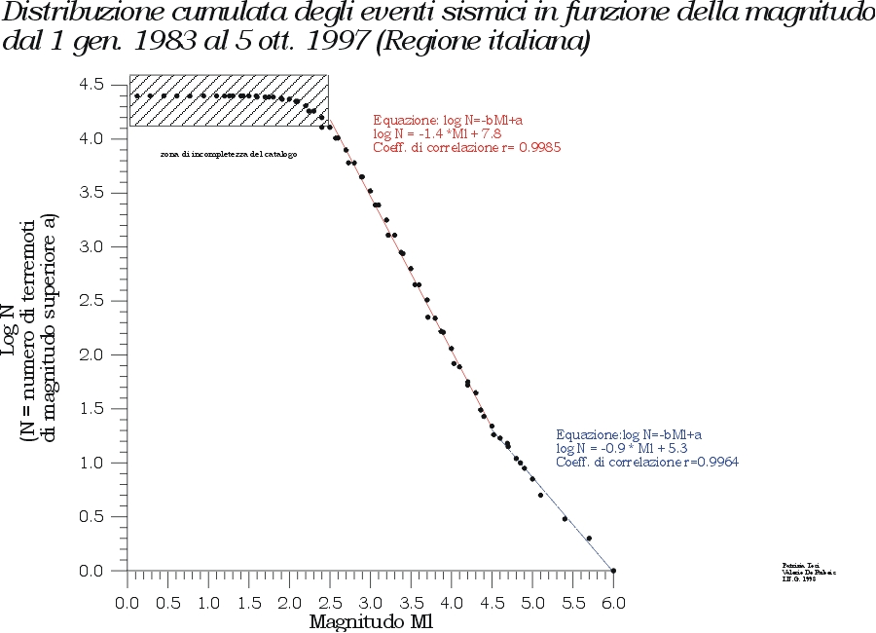
Trento, 02 December 2020
Ph.D. Student: Chiara Nardin
chiara.nardin@unitn.it
Introduction | Probabilistic Hazard Analysis | Fragility Analysis | References
PSHA – Step 2: Earthquake size (Recurrence law)
Observations:
http://legacy.ingv.it/roma/attivita/pererischio/macrosismica/Seismic/seismic.html
Notes:
Here some picture of the distribution of seismic events given magnitude are represent and plotted. IN particular it could be appreciated the comparison or better the application of both GR and GR bounded.

Slide 18
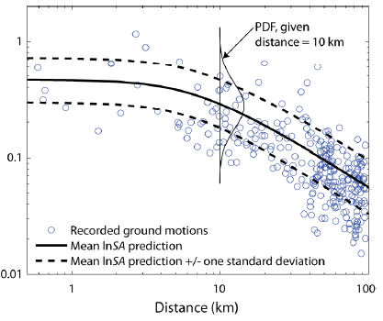
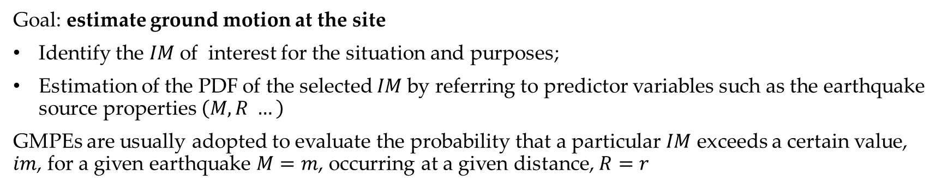
Trento, 02 December 2020
Ph.D. Student: Chiara Nardin
chiara.nardin@unitn.it
Introduction | Probabilistic Hazard Analysis | Fragility Analysis | References
PSHA – Step 3: Ground motion predictive equations (GMPE)
Goal: estimate ground motion at the site
Identify the $IM$of interest for the situation and purposes;
Estimation of the PDF of the selected $IM$by referring to predictor variables such as the earthquake source properties $\left(M,R …\right)$
GMPEs are usually adopted to evaluate the probability that a particular $IM$ exceeds a certain value, $im$, for a given earthquake $M=m$, occurring at a given distance, $R=r$
Notes:
Once the distribution of potential earthquakes magnitudes and locations has been identi_ed, we can
evaluate the ground motion at the site. There are two basic steps to estimate the ground motion at the
site.
i Identification of the important characteristics of the ground motion (i.e. the intensity measures). The selection of the IM of interest (amplitude, frequency and/or duration-based) depends on the element at risk under consideration and on the purposes of the analysis.
Estimation of the probability distribution of the selected IM must be estimated as a function of predictor variables such as the earthquake source properties, the relative location of the earthquake respect to the site, and the soil conditions

Slide 19
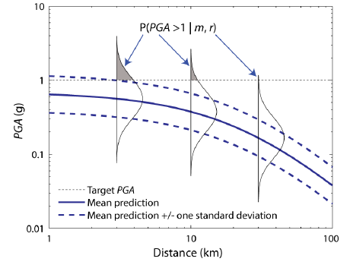
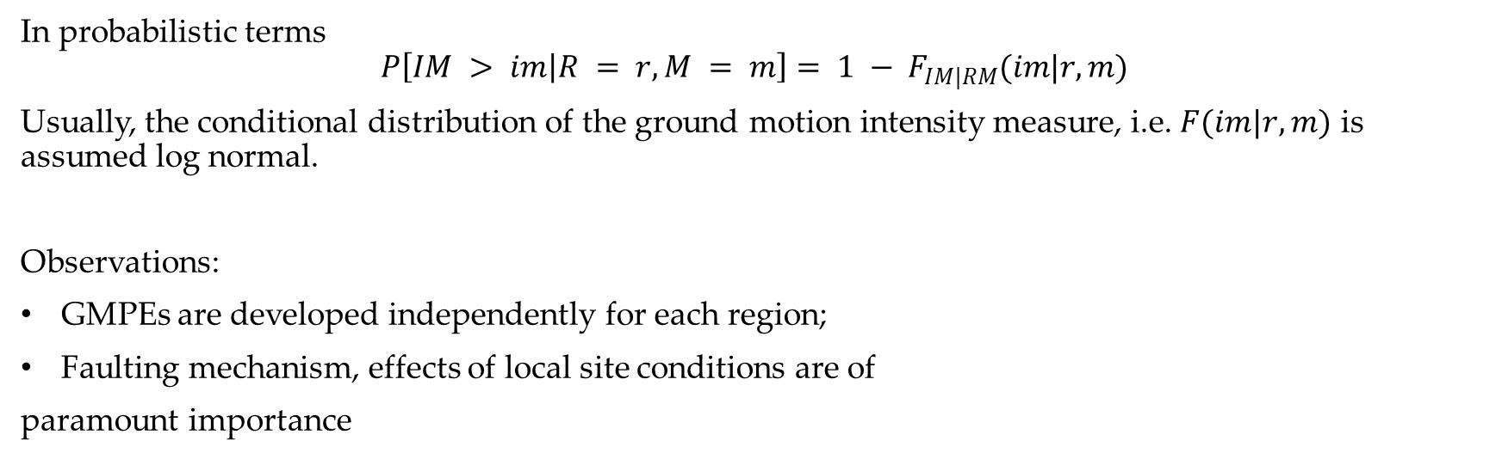
Trento, 02 December 2020
Ph.D. Student: Chiara Nardin
chiara.nardin@unitn.it
Introduction | Probabilistic Hazard Analysis | Fragility Analysis | References
PSHA – Step 3: Ground motion predictive equations (GMPE)
In probabilistic terms
$$P\left[IM > im | R = r,M = m\right]= 1 − F_{IM|RM}(im|r,m)$$
Usually, the conditional distribution of the ground motion intensity measure, i.e. $F(im|r,m)$ is assumed log normal.
Observations:
GMPEs are developed independently for each region;
Faulting mechanism, effects of local site conditions are of
paramount importance
Schematic illustration of conditional probability of exceeding a particular value of a
ground motion parameter for a given magnitude and distance.
Notes:
Ground motion prediction equations (GMPEs) are usually adopted to evaluate the probability that a particular IM exceeds a certain value, im, for a given earthquake M = m, occurring at a given distance, R = r, (as illustrated graphically in Figure beside). In probabilistic terms, this is written as P[IM > imjR = r;M = m] = 1 􀀀 FIMjRM(imjr;m).
In general, the conditional distribution of the ground motion intensity measure, i.e. F(imjr;m) is assumed
log normal. It follow that the logarithm of the conditional intensity measure is normally distributed.
Some observations to mention. Well, over decades of development, the prediction models have become complex, consisting of many parameters. More speci_cally, many factors related to source and site characteristics
are considered and among all the parameters involved, faulting mechanism effect of local site conditions are of paramount importance.

Slide 20
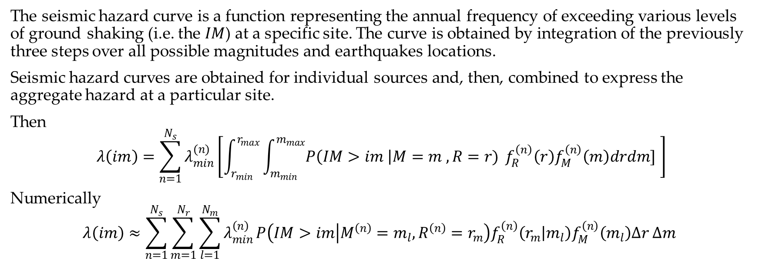
Trento, 02 December 2020
Ph.D. Student: Chiara Nardin
chiara.nardin@unitn.it
Introduction | Probabilistic Hazard Analysis | Fragility Analysis | References
PSHA – Step 4: Hazard Computation
The seismic hazard curve is a function representing the annual frequency of exceeding various levels of ground shaking (i.e. the $IM$) at a specific site. The curve is obtained by integration of the previously three steps over all possible magnitudes and earthquakes locations.
Seismic hazard curves are obtained for individual sources and, then, combined to express the aggregate hazard at a particular site.
Then
$$λ\left(im\right)=\sum_{n=1}^{N_{s}}{λ_{min}^{(n)}}\left[\int_{r_{min}}^{r_{max}}{\int_{m_{min}}^{m_{max}}{P\left(IM>im \right|M=m , R=r)}} f_{R}^{\left(n\right)}\left(r\right)f_{M}^{\left(n\right)}\left(m\right)drdm] \right]$$
Numerically
$$λ\left(im\right)≈\sum_{n=1}^{N_{s}}{\sum_{m=1}^{N_{r}}{\sum_{l=1}^{N_{m}}{λ_{min}^{\left(n\right)}}P\left(IM>im | M^{\left(n\right)}=m_{l}, R^{\left(n\right)}=r_{m}\right)f_{R}^{\left(n\right)}\left(r_{m} | m_{l}\right)f_{M}^{\left(n\right)}\left(m_{l}\right)Δr Δm} }$$
(2)
(3)
Notes:
Then finally the last step: the hazard computation.
The seismic hazard curve is a function representing the annual frequency of exceeding various levels of
ground shaking (i.e. the IM) at a speci_c site. The curve is obtained by integration of the _rst three
steps over all possible magnitudes and earthquakes locations.
Seismic hazard curves are obtained for individual sources and, then, combined to express the aggregate
hazard at a particular site.
Given Ns statistically independent sources, the aggregate hazard curve is derived by merging all the Ns
Poisson process. Then, numerical integration is required.

Slide 21

Trento, 02 December 2020
Ph.D. Student: Chiara Nardin
chiara.nardin@unitn.it
Probabilistic Hazard Analysis
Formulation and MatLab Computation
Ph.D. Student Chiara Nardin – M.Sc., Eng. in Civil Engineering
https://github.com/kia13nn/ISPS.git

Slide 22
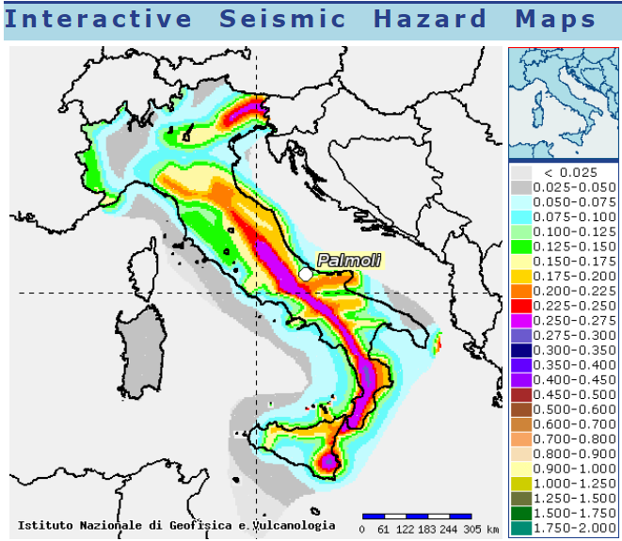
Trento, 02 December 2020
Ph.D. Student: Chiara Nardin
chiara.nardin@unitn.it
Introduction | Probabilistic Hazard Analysis | Fragility Analysis | References
Goal: to perform a PSHA analysis
Through the scheme depicted in (1), compute:
the annual hazard curve for each fault;
the 50 years hazard curve for each fault;
the 475 years hazard curve for each fault
for the highlighted seismic site.
http://esse1-gis.mi.ingv.it/
Seismic hazard map: shaking parameter PGA, site Palmoli (CH) Latitude 41,527 – Longitude 14,483.
Notes:
Now let’s see with Matlab how to perform a PSHA analysis of a site located in Italy and then, if someone is curious, we can compare it with results from the interactive seismic hazard map of the Italian National institute INGV, by applying just some modification to our code.
The goals are here reported, so basically to compute the hazard curve for each fault annual, at 50 years or at 475 years. What we expect, reasonably, is that the last one hazard curve is going to have an higher rate of exceedance, since, as one can imagine, it has a major return period so chance to see more seismic events. Let’s try to dramatically simplified in this way our expectations.

Slide 23
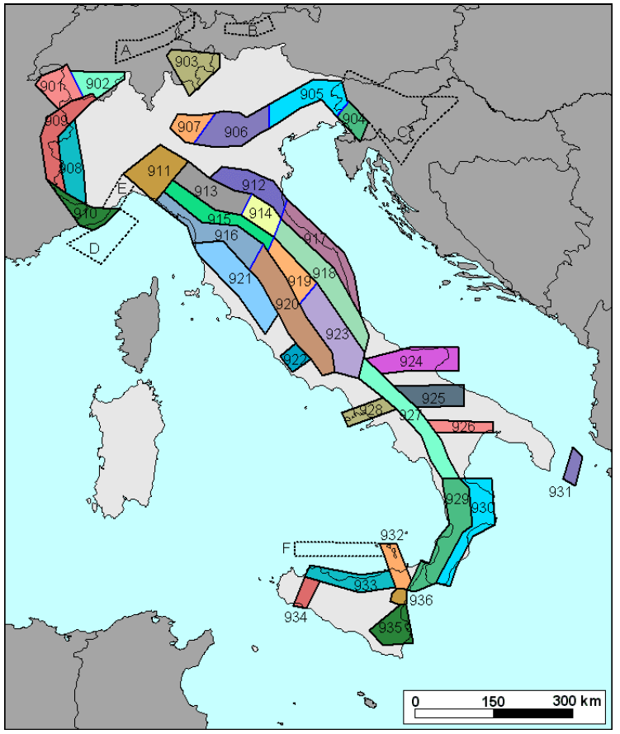
Trento, 02 December 2020
Ph.D. Student: Chiara Nardin
chiara.nardin@unitn.it
Introduction | Probabilistic Hazard Analysis | Fragility Analysis | References
Step 1: Source characterization
Localize seismogenetic zones: Italian ZS9* model for application of the attenuation law
Different characteristics of zonation by:
Seismogenetic faults and mechanisms (direct, inverse, strike-slip …)
Hypocenter depth (shallow, intermediate, deep)
ect.
Italian database and catalogue of the overall seismicity
http://zonesismiche.mi.ingv.it/
Notes:
As first step we have seen that we need to characterize sources involved in hazard evaluation.
To do so, we need to access for example to the database and catalogue provided by the Italian National Institute INGV. Here we found data and material needed for the localization of the seismogenetic zones. In particular, the updated catalogue and model for the Italian GMPE is the so called ZS9.
In this seismological zonation, we find different categories based on distinct characteristics such as fault mechanism, hypocenter depth and so on.

Slide 24
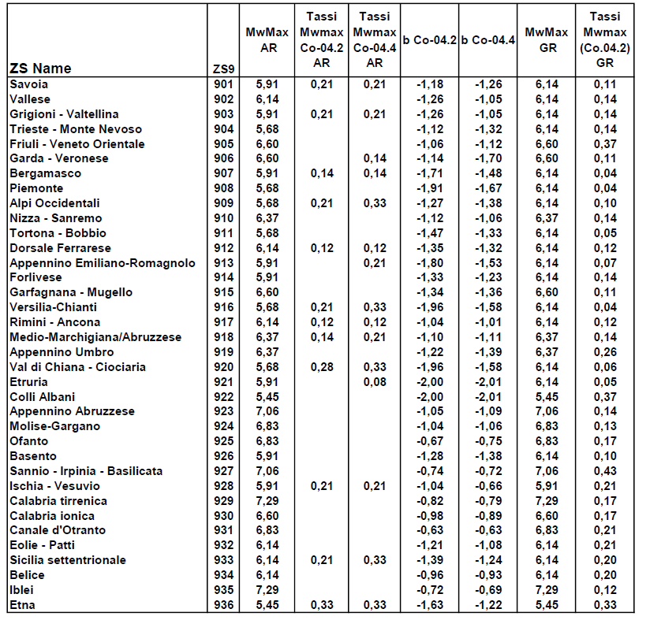
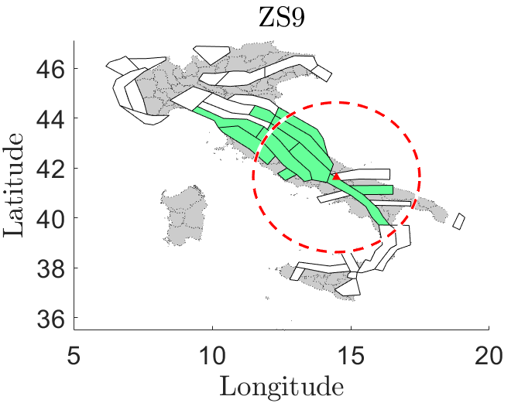
Trento, 02 December 2020
Ph.D. Student: Chiara Nardin
chiara.nardin@unitn.it
Introduction | Probabilistic Hazard Analysis | Fragility Analysis | References
Step 1: Source characterization
Localize seismogenetic zones: Italian ZS9* model for application of the attenuation law
http://zonesismiche.mi.ingv.it/
Notes:
Here, since we placed ourselves in Palmoli, middle of Italy, we have selected some of the seismogenetic zone useful or interesting for the hazard curve calculation. In particular, from this table, some useful information are already reported, such as coefficient b of GR, m max and m min ect.

Slide 25
Trento, 02 December 2020
Ph.D. Student: Chiara Nardin
chiara.nardin@unitn.it
Introduction | Probabilistic Hazard Analysis | Fragility Analysis | References
Step 1: Source characterization
Extrapolate information regarding the source and its bound limits: convert coordinates from deg2utm for each sources
 | Coordinates
 | WGS 84 |  | UTM |  | UTM-Z
Location | long (x) | lat (y)
Palmoli | 14,48 | 41,63 | 465.293 | 4643124 | 33 T
ZS9-918 | S1
WGS 84 |  | UTM |  | UTM-Z | UTM-INPORT
12,11651 | 43,79397 | 268015,9 | 4853032 | 33 T | -197.277 | 209.907
12,27012 | 44,10645 | 281523,5 | 4887320 | 33 T | -183.769 | 244.196
13,54116 | 43,2943 | 381660,3 | 4794530 | 33 T | -83.633 | 151.405
14,181 | 42,47483 | 432678,9 | 4702824 | 33 T | -32.614 | 59.699
14,37249 | 42,14993 | 448153,3 | 4666614 | 33 T | -17.140 | 23.489
14,27923 | 41,85719 | 440174,4 | 4634171 | 33 T | -25.118 | -8.953
13,1518 | 43,02822 | 349423 | 4765606 | 33 T | -115.870 | 122.481
12,11651 | 43,79397 | 268015,9 | 4853032 | 33 T | -197.277 | 209.907
Source | b | Mw Max | Mw Min | Rate
S1 | -1,11 | 6,37 | 4,76 | 0,21
S2 | -1,09 | 7,06 | 4,76 | 0,14
… | … | … | … | …
Notes:
Besides, in this first phase, also geometrical information about how to model the seismic source are needed: in the same catalogue are reported the coordinates that define the polygon of the area source.
These, for calculation purposes, are then converted in a more suitable format and reported in a cartesian reference system.

Slide 26
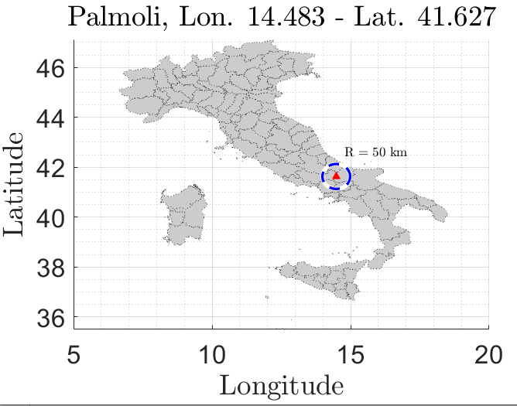
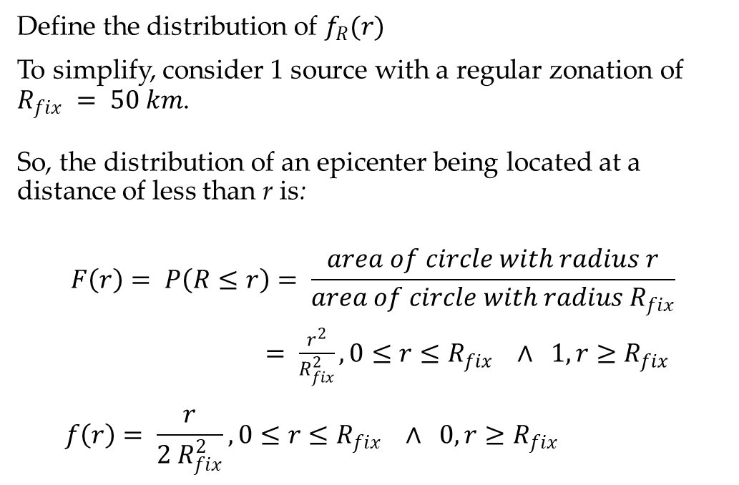
Trento, 02 December 2020
Ph.D. Student: Chiara Nardin
chiara.nardin@unitn.it
Introduction | Probabilistic Hazard Analysis | Fragility Analysis | References
Step 1: Source characterization - Location
Define the distribution of $f_{R}(r)$
To simplify, consider 1 source with a regular zonation of $R_{fix} = 50 km$.
So, the distribution of an epicenter being located at a distance of less than r is:
$$F\left(r\right)= P\left(R≤r\right)= \frac{area of circle with radius r}{area of circle with radius R_{fix}}$$
$= \frac{r^{2}}{R_{fix}^{2}}, 0≤r≤R_{fix} ∧ 1, r≥R_{fix}$
$$f\left(r\right)= \frac{r}{{2 R}_{fix}^{2}}, 0≤r≤R_{fix} ∧ 0, r≥R_{fix}$$
CDF:
PDF:
Notes:
In this way, it is possible to compute the pdf distribution of site-to-source distance. Just for sake of clarity, here is reported a conventional circular zonation: the maths in this way is simplified, as the definition of the CDF corresponds to an analytically easy close form. We can therefore interpret the CDF as the ratio between area of circle with radius small r over area of circle of fixed radius, in this case 50 km.
So, since pdf is the derivative of CDF, we obtain a linear probability distribution of site-to-source distance.

Slide 27
Trento, 02 December 2020
Ph.D. Student: Chiara Nardin
chiara.nardin@unitn.it
Introduction | Probabilistic Hazard Analysis | Fragility Analysis | References
Step 1: Source characterization
Codes:
Read source.xls file
Run section Earthquake source characterization in the attached Matlab code or load variable seismic_source.mat already prepared with the previously seen data
Notes:
These steps corresponds to the following sections in the codes provided. So there is a pre-processing section in the m-file inside which data from the INGV catalogue are read and prepared for further elaboration.

Slide 28
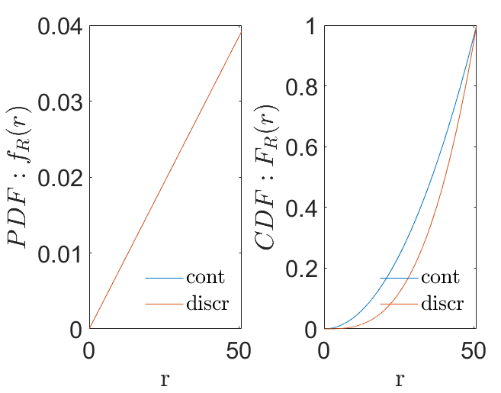
Trento, 02 December 2020
Ph.D. Student: Chiara Nardin
chiara.nardin@unitn.it
Introduction | Probabilistic Hazard Analysis | Fragility Analysis | References
Step 1: Source characterization - Location
Codes:
% PDF of R
rmax = Rmax*100; % 50km
rmin = Rmin.*100; % site
r_step = R_step;
r = rmin:r_step:(rmax-r_step);
Fr = r.^2./rmax.^2;
fr = 2*r./rmax.^2;
DFr = r_step;
frdiscr = zeros(1,numel(Fr));
Frdiscr = zeros(1,numel(Fr));
for idr = 2:numel(Fr)
frdiscr(idr) = -(Fr(idr-1)-Fr(idr))./(DFr);
Frdiscr(idr) = Frdiscr(idr-1)+Fr(idr);
end
Notes:
As It possible to see, the pdf of distance is discretized and plotted. Plots show the effect of how a low or bad step of integration can influence results and convergence. As always there’s a penalty to pain: increasing number steps causes the computational effort needed, so it has to be an informed decision.

Slide 29
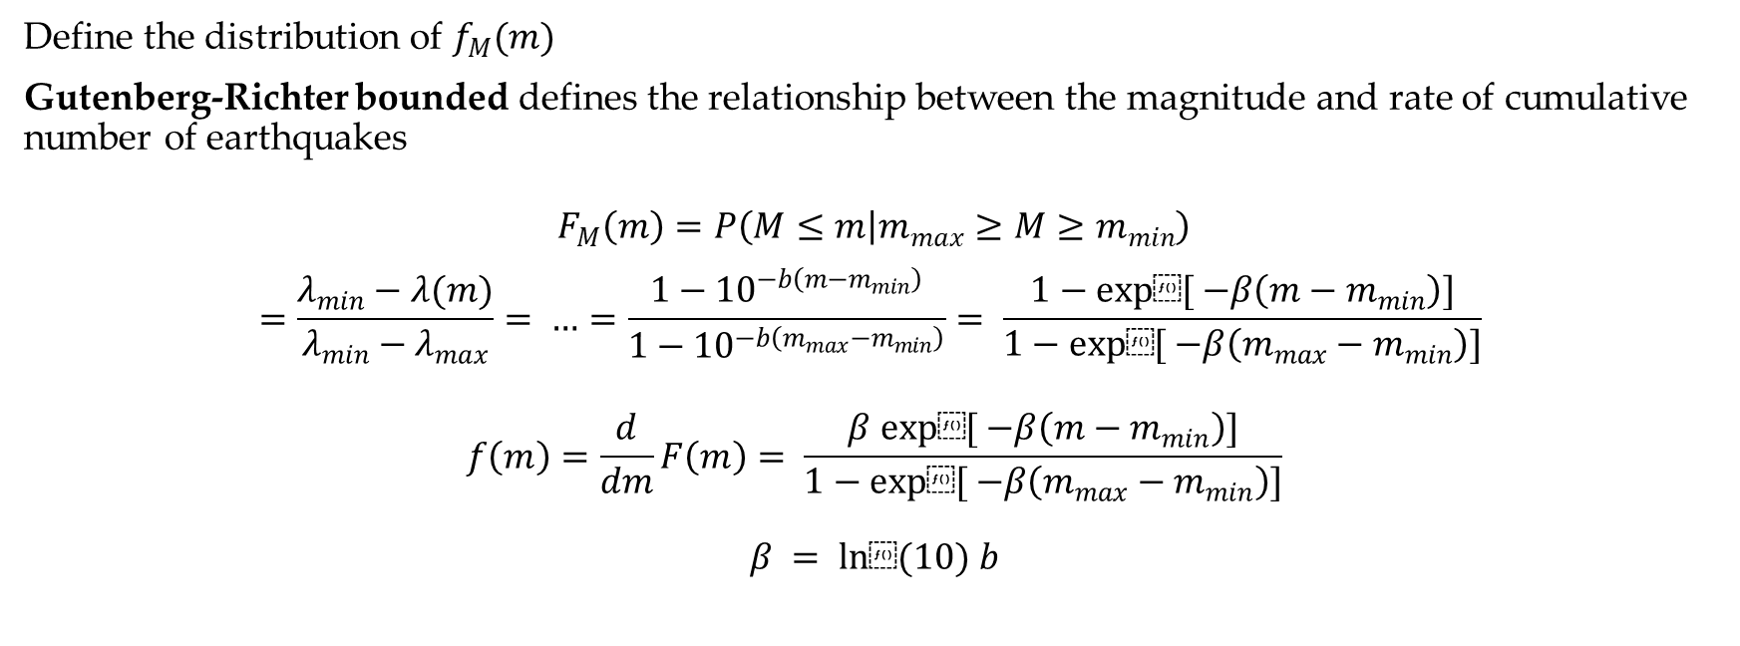
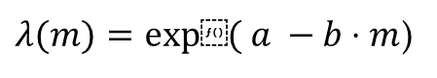
Trento, 02 December 2020
Ph.D. Student: Chiara Nardin
chiara.nardin@unitn.it
Introduction | Probabilistic Hazard Analysis | Fragility Analysis | References
Step 2: Earthquake size
$λ(m)=exp⁡( a −b⋅m$)
Define the distribution of $f_{M}(m)$
Gutenberg-Richter bounded defines the relationship between the magnitude and rate of cumulative number of earthquakes
$$F_{M}\left(m\right)=P\left(M≤m | m_{max}≥M≥m_{min}\right)$$
$$=\frac{λ_{min}−λ(m)}{λ_{min}−λ_{max}}= …=\frac{1−{10}^{−b\left(m−m_{min}\right)}}{1−{10}^{−b\left(m_{max}−m_{min}\right)}}= \frac{1−exp⁡[ −β\left(m−m_{min}\right)]}{1−exp⁡[ −β\left(m_{max}−m_{min}\right)]}$$
$$f\left(m\right)=\frac{d}{dm}F\left(m\right)= \frac{β exp⁡[ −β\left(m−m_{min}\right)]}{1−exp⁡[ −β\left(m_{max}−m_{min}\right)]}$$
$$β = ln⁡(10) b$$
CDF:
PDF:
Notes:
Then, as second step, it is possible to evaluate the pdf distribution of magnitude by considering GR bounded law. Again, starting from CDF and by remembering the definition, it is possible to derive also the pdf.

Slide 30
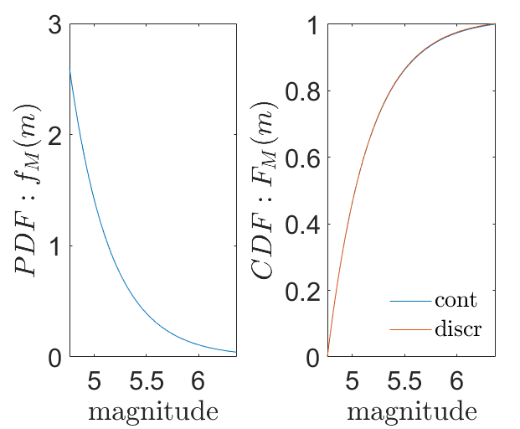
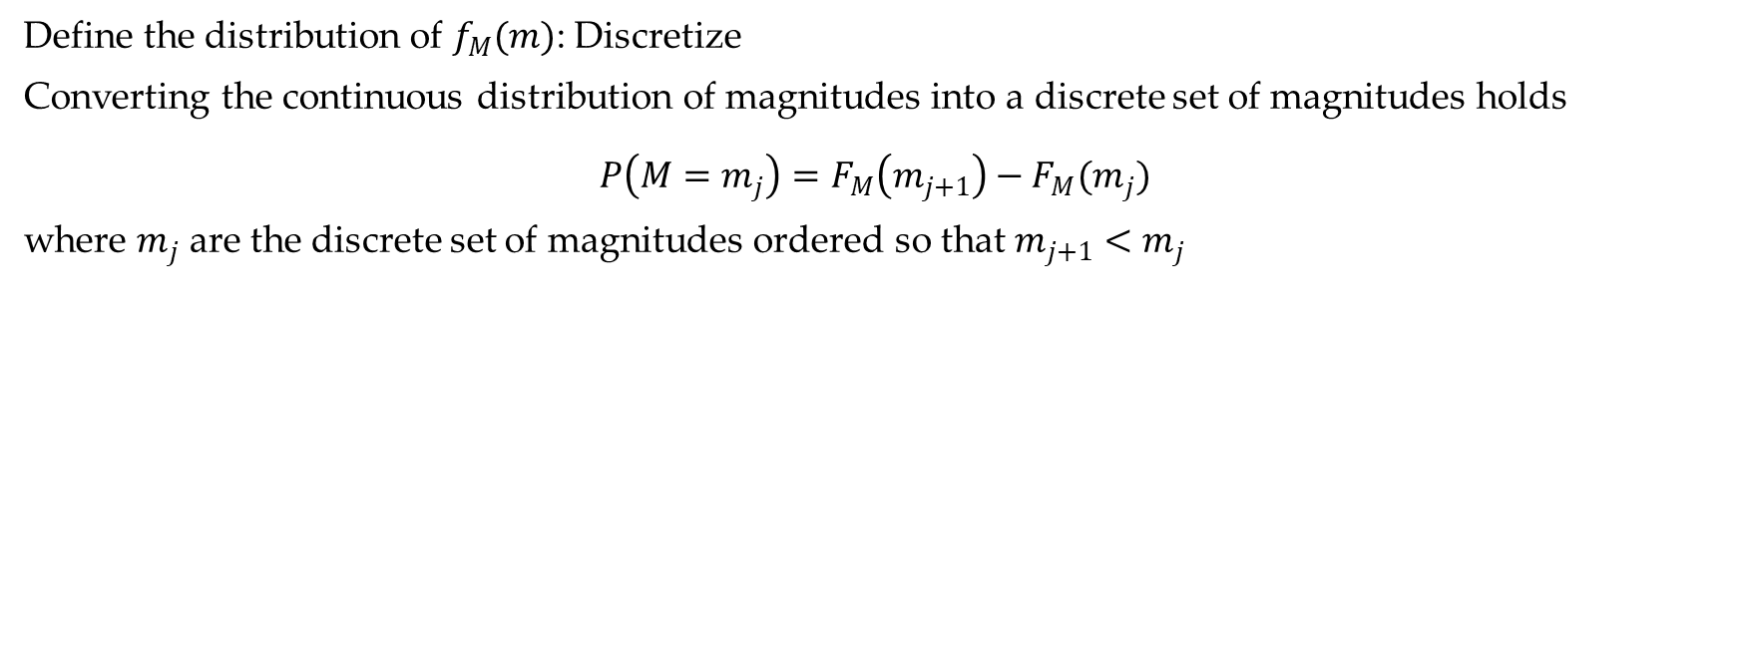
Trento, 02 December 2020
Ph.D. Student: Chiara Nardin
chiara.nardin@unitn.it
Introduction | Probabilistic Hazard Analysis | Fragility Analysis | References
Step 2: Earthquake size
Define the distribution of $f_{M}(m)$: Discretize
Converting the continuous distribution of magnitudes into a discrete set of magnitudes holds
$$P\left(M=m_{j}\right)=F_{M}\left(m_{j+1}\right)−F_{M}(m_{j})$$
where $m_{j}$ are the discrete set of magnitudes ordered so that $m_{j+1}<m_{j}$
Codes:
% PDF of M
Nm = 1000; % No. of discretized points between m0 and mu for numerical integration
M = linspace(m0,mu,Nm); %mo = m_min
fM = beta*exp(-beta*(M-m0))/(1-exp(-beta*(mu-m0)));
dM=M(2)-M(1);
Mdiscr=fM*dM;
Notes:
Again, here are plotted the continuous and discretized form of the PDF and CDF for magnitude.
The codes reported are simply the formulation rewritten in matlab.

Slide 31
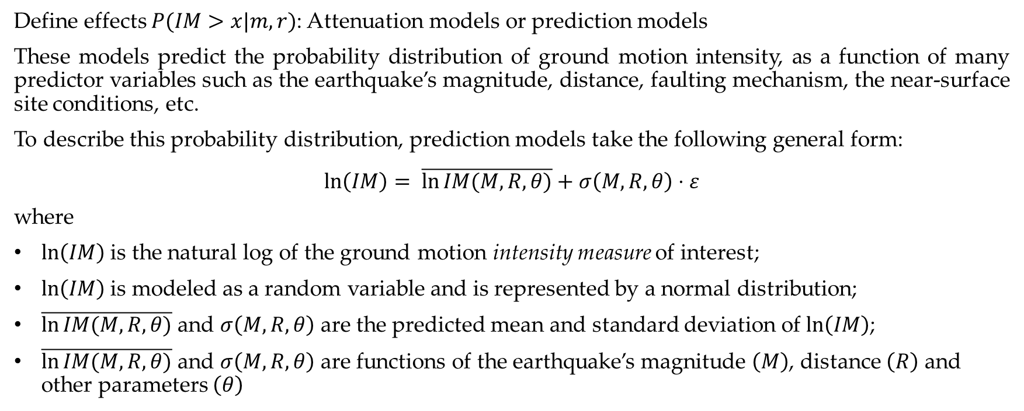
Trento, 02 December 2020
Ph.D. Student: Chiara Nardin
chiara.nardin@unitn.it
Introduction | Probabilistic Hazard Analysis | Fragility Analysis | References
Step 3: Ground motion estimation
Define effects $P(IM>x|m,r)$: Attenuation models or prediction models
These models predict the probability distribution of ground motion intensity, as a function of many predictor variables such as the earthquake’s magnitude, distance, faulting mechanism, the near-surface site conditions, etc.
To describe this probability distribution, prediction models take the following general form:
$$\ln\left(IM\right)= \overline{\ln{IM(M,R,θ)}}+σ\left(M,R,θ\right)⋅ε$$
where
$ln\left(IM\right)$ is the natural log of the ground motion intensity measure of interest;
$ln\left(IM\right)$ is modeled as a random variable and is represented by a normal distribution;
$\overline{\ln{IM(M,R,θ)}}$ and $σ\left(M,R,θ\right)$ are the predicted mean and standard deviation of $ln\left(IM\right)$;
$\overline{\ln{IM(M,R,θ)}}$ and $σ\left(M,R,θ\right)$ are functions of the earthquake’s magnitude $\left(M\right)$, distance $\left(R\right)$ and other parameters $\left(θ\right)$
Notes:
At this stage, we need to implement the most delicate phase of the hazard analysis: the prediction equation or the conditional probability that we have seen before. GMPE are model capable to predict the pdf of ground motion intensity as function of predictor variables such as magnitude, distance and other parameters. Generally, they are based on the form here reported.

Slide 32
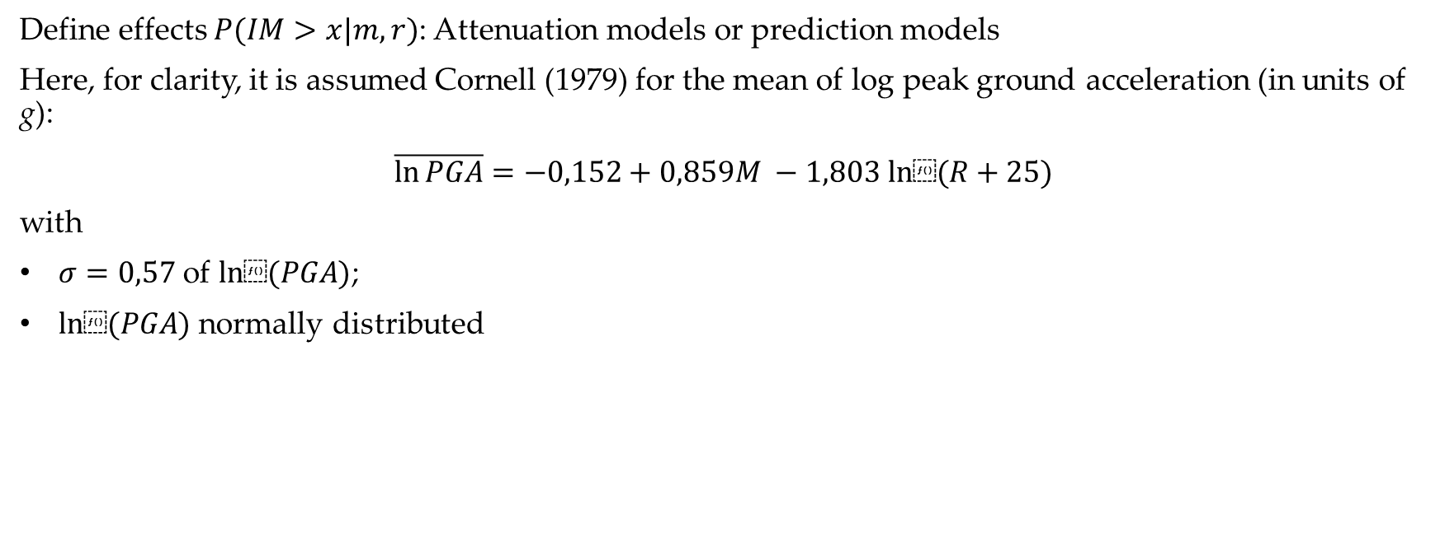
Trento, 02 December 2020
Ph.D. Student: Chiara Nardin
chiara.nardin@unitn.it
Introduction | Probabilistic Hazard Analysis | Fragility Analysis | References
Step 3: Ground motion estimation
Define effects $P(IM>x|m,r)$: Attenuation models or prediction models
Here, for clarity, it is assumed Cornell (1979) for the mean of log peak ground acceleration (in units of g):
$$\overline{\ln{PGA}}=−0,152+0,859M −1,803 ln⁡(R+25)$$
with
$σ=0,57$ of $ln⁡(PGA)$;
$ln⁡(PGA)$ normally distributed
Notes:
Just for simplicity, here is reported the predictive equation of Cornell that is for PGA intensity measure. It is a formulation functions of magnitude and site distance with some constants value calibrated.
Just an observation: in the Italian database Sabetta Pugliese law is the one applied to evaluate the hazard map. In codes you will find the possibility to change or implement that: it requires more data that are collected all in the documentation provided by the INGV.

Slide 33
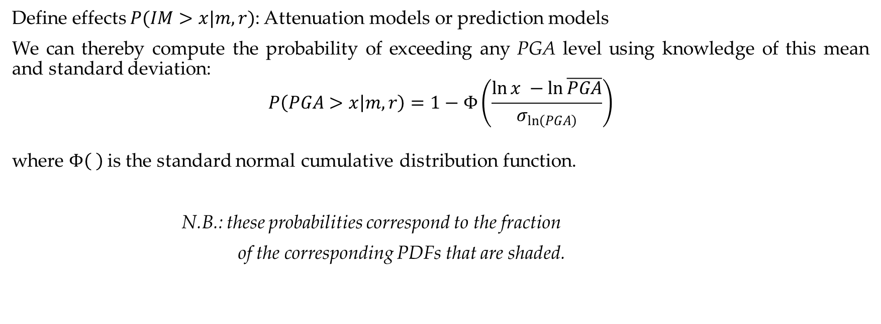
Trento, 02 December 2020
Ph.D. Student: Chiara Nardin
chiara.nardin@unitn.it
Introduction | Probabilistic Hazard Analysis | Fragility Analysis | References
Step 3: Ground motion estimation
Define effects $P(IM>x|m,r)$: Attenuation models or prediction models
We can thereby compute the probability of exceeding any PGA level using knowledge of this mean and standard deviation:
$$P\left(PGA>x | m,r\right)=1−Φ\left(\frac{\ln{x −\ln{\overline{PGA}}}}{σ_{\ln\left(PGA\right)}}\right)$$
where $Φ\left( \right)$is the standard normal cumulative distribution function.
N.B.: these probabilities correspond to the fraction
of the corresponding PDFs that are shaded.
Notes:
We can thereby compute the probability of exceeding any PGA level by evaluating the conditional probability applying for example the Cornell law. As we noticed, the conditional probability can be evaluated as the complement of the cumulative distribution function.
To give a visual idea of what we are computing we can give a look to the figure below: for a given magnitude and distance, we are interested in the probability of the intensity measure PGA, so the pdf here plotted for different distances, greater than a threshold: we are looking for the coloured part of the drawn pdf.

Slide 34
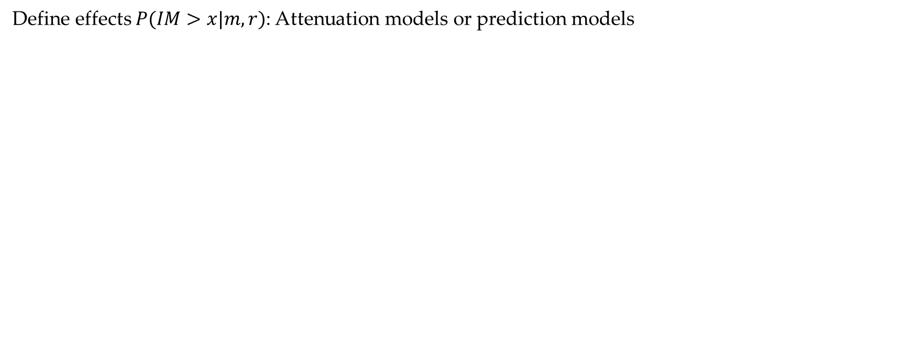
Trento, 02 December 2020
Ph.D. Student: Chiara Nardin
chiara.nardin@unitn.it
Introduction | Probabilistic Hazard Analysis | Fragility Analysis | References
Step 3: Ground motion estimation
Define effects $P(IM>x|m,r)$: Attenuation models or prediction models
Codes:
function [mean_im, sigma_im] = GMPE(magnitude,R_distance)
%Cornell et al. (1979): Ground motion predictive equation for PGA
mean_lnPGA = -0.152+0.859*magnitude -1.803*log(R_distance+25);
mean_PGA = exp(mean_lnPGA);
mean_im = mean_PGA;
sigma_im = 0.57;
end
Notes:
Here the coded example of the attenuation law of Cornell

Slide 35
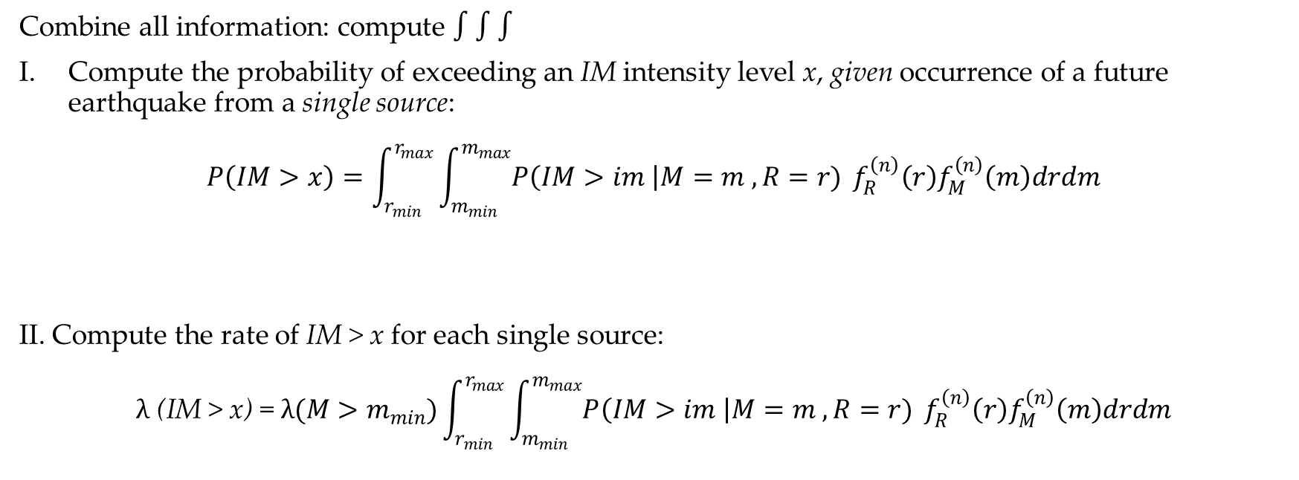
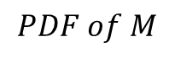


Trento, 02 December 2020
Ph.D. Student: Chiara Nardin
chiara.nardin@unitn.it
Introduction | Probabilistic Hazard Analysis | Fragility Analysis | References
Step 4: Hazard Computation
Combine all information: compute $∫∫∫$
Compute the probability of exceeding an IM intensity level x, given occurrence of a future earthquake from a single source:
$$P\left(IM>x\right)=\int_{r_{min}}^{r_{max}}{\int_{m_{min}}^{m_{max}}{P\left(IM>im \right|M=m , R=r)}} f_{R}^{\left(n\right)}\left(r\right)f_{M}^{\left(n\right)}\left(m\right)drdm$$
II. Compute the rate of IM > x for each single source:
$$λ \text{(}\text{IM} \text{> }\text{x}\text{)} \text{=} λ(M>m_{min})\int_{r_{min}}^{r_{max}}{\int_{m_{min}}^{m_{max}}{P\left(IM>im \right|M=m , R=r)}} f_{R}^{\left(n\right)}\left(r\right)f_{M}^{\left(n\right)}\left(m\right)drdm$$
$$from GMPE$$
$$PDF of R$$
$$PDF of M$$
Notes:
So finally we need to compute the hazard by combining all the previous info.
We compute the probability of exceedance first, then the rate by multipling for the rate of exceedance of earthquakes for the selected source.

Slide 36

Trento, 02 December 2020
Ph.D. Student: Chiara Nardin
chiara.nardin@unitn.it
Introduction | Probabilistic Hazard Analysis | Fragility Analysis | References
Step 4: Hazard Computation
Combine all information: compute $∫∫∫$
III. Considering all sources by the sum of the rates of IM > x from each individual source, we can write:
$$λ\left(IM>x\right)=\sum_{i=1}^{n_{sources}}{λ(M_{i}>m_{min})\int_{r_{min}}^{r_{max}}{\int_{m_{min}}^{m_{max}}{P\left(IM>im \right|M=m , R=r)}} f_{R_{i}}^{\left(n\right)}\left(r\right)f_{M_{i}}^{\left(n\right)}\left(m\right)drdm }$$
where $n_{sources}$ is the number of sources considered, and $M_{i} \sim R_{i}$ denote the magnitude ~ distance
distributions for source i
Notes:
$$λ(M>m_{min})\int_{r_{min}}^{r_{max}}{\int_{m_{min}}^{m_{max}}{P\left(IM>im \right|M=m , R=r)}} f_{R}^{\left(n\right)}\left(r\right)f_{M}^{\left(n\right)}\left(m\right)drdm$$
And finally we consider all the involved sources in the hazard computation.

Slide 37

Trento, 02 December 2020
Ph.D. Student: Chiara Nardin
chiara.nardin@unitn.it
Introduction | Probabilistic Hazard Analysis | Fragility Analysis | References
Step 4: Hazard Computation
Combine all information: compute $∫∫∫$ - Discretize
IV. By discretizing:
$${λ\left(im\right)≈\sum_{n=1}^{N_{s}}{\sum_{m=1}^{N_{r}}{\sum_{l=1}^{N_{m}}{λ_{min}^{\left(n\right)}}P\left(IM>im | M^{\left(n\right)}=m_{l}, R^{\left(n\right)}=r_{m}\right)P\left(R^{\left(n\right)}=r_{m} | m_{l}\right)P(M^{(n)}=m_{l})} }}_{}$$
where the range of possible $M_{i}$ and $R_{i}$ have been discretized into $n_{M}$ and $n_{R}$ intervals, respectively
Notes:
$$\text{By} \text{discretizing} \text{for} \text{the} \text{numerical} \text{solution}$$

Slide 38

Trento, 02 December 2020
Ph.D. Student: Chiara Nardin
chiara.nardin@unitn.it
Introduction | Probabilistic Hazard Analysis | Fragility Analysis | References
Step 4: Hazard Computation
Goal and results
Through the scheme depicted in (1), compute:
the annual hazard curve for each fault;
the 50 years hazard curve for each fault;
the 475 years hazard curve for each fault
for the highlighted seismic site.
Notes:
So here are reported the solution we can obtain by running the provided code in matlab.

Slide 39


Trento, 02 December 2020
Ph.D. Student: Chiara Nardin
chiara.nardin@unitn.it
Introduction | Probabilistic Hazard Analysis | Fragility Analysis | References
Step 4: Hazard Computation
Notes:
$$λ(M>m_{min})\int_{r_{min}}^{r_{max}}{\int_{m_{min}}^{m_{max}}{P\left(IM>im \right|M=m , R=r)}} f_{R}^{\left(n\right)}\left(r\right)f_{M}^{\left(n\right)}\left(m\right)drdm$$

Slide 40
Trento, 02 December 2020
Ph.D. Student: Chiara Nardin
chiara.nardin@unitn.it
Introduction | Probabilistic Hazard Analysis | Fragility Analysis | References
Summary
Location
$P=1−e^{−λt}$ Poisson model
𝑃=1−𝑒^(−𝜆𝑡) Poisson model
Size
Time
$f_{R}\left(r\right)$ source site distance
𝑓_𝑅 (𝑟) source site distance
GMPE
$f_{M}\left(m\right)$ magnitude distribution
𝑓_𝑀 (𝑚) magnitude distribution
$P\left(IM>im \right|M=m , R=r)$ attenuation law
𝑃(𝐼𝑀>𝑖𝑚 ┤|𝑀=𝑚 , 𝑅=𝑟) attenuation law
Notes:
$$λ(M>m_{min})\int_{r_{min}}^{r_{max}}{\int_{m_{min}}^{m_{max}}{P\left(IM>im \right|M=m , R=r)}} f_{R}^{\left(n\right)}\left(r\right)f_{M}^{\left(n\right)}\left(m\right)drdm$$

Slide 41
Trento, 02 December 2020
Ph.D. Student: Chiara Nardin
chiara.nardin@unitn.it
Fragility Analysis
Formulation and MatLab Computation
Ph.D. Student Chiara Nardin – M.Sc., Eng. in Civil Engineering
Notes:
Welcome back. Let’s focus now on the fragility analysis.

Slide 42
Trento, 02 December 2020
Ph.D. Student: Chiara Nardin
chiara.nardin@unitn.it
Introduction | Probabilistic Hazard Analysis | Fragility Analysis | References
Fragility Analysis
Hazard analysis
intensity measure
Loss analysis
decision variable
HAZARD
VULNERABILITY
Damage analysis
damage measure
DECISION MAKING
VULNERABILITY
Vulnerability analysis
engineering demand par.
Fragility (or Vulnerability) Analysis is the second step of the PBEE-PEER framework
Useful definitions:
seismic fragility function := the conditional probability of an event (e.g. a defined limit/damage state) given the observation of an intensity measure which describe the seismic event.
$$p\left(IM\right|M,R)$$
$$↓$$
$$p(IM)$$
$$p\left(EDP\right|IM)$$
$$↓$$
$$p(EDP)$$
$$p\left(DM\right|EDP)$$
$$↓$$
$$p(DM)$$
$$p\left(DV\right|DM)$$
$$↓$$
$$p(DV)$$
Notes:
Fragility analysis represent the next step on the PBEE framework that we have seen in the first part of the lecture.
Its definition is below reported: again, fragility is defined as the conditional probability of an event, a defined limit state, given the observation of an intensity measure which describe the seismic event.

Slide 43




Trento, 02 December 2020
Ph.D. Student: Chiara Nardin
chiara.nardin@unitn.it
Introduction | Probabilistic Hazard Analysis | Fragility Analysis | References
Fragility Analysis
Vulnerability analysis
engineering demand par.
The fragility curve is defined as the conditional probability of failure of a structure, or its critical components, at given values of seismic intensity measures (IMs).
In practice, a fragility curve is calculated as the conditional probability that the damage measure (D) exceeds a critical threshold, for a given seismic IM.
$$P \left(D>d_{threshold} \right| IM=im)$$
VULNERABILITY
$$p\left(EDP\right|IM)$$
$$↓$$
$$p(EDP)$$
Damage analysis
damage measure
VULNERABILITY
$$p\left(DM\right|EDP)$$
$$↓$$
$$p(DM)$$
Notes:
Fragility analysis involved both vulnerability and damage analysis, since it requires the evaluation of both probability of EDPconditioned by IM and DM conditioned by EDP.
In fact, by definition, the fragility curve is defined as the conditional probability of failure of a structure or its critical component, at given values of seismic intensity.
In practice a fragility is calculated as the conditional probability tha the damage measure D exceeds a critical threshold for a given seismic IM.

Slide 44


Trento, 02 December 2020
Ph.D. Student: Chiara Nardin
chiara.nardin@unitn.it
Introduction | Probabilistic Hazard Analysis | Fragility Analysis | References
Fragility Analysis
Vulnerability analysis
engineering demand par.
$$P \left(D>d_{threshold} \right| IM=im)$$
Fragility curves for different damage limit states or thresholds.
VULNERABILITY
$$p\left(EDP\right|IM)$$
$$↓$$
$$p(EDP)$$
Damage analysis
damage measure
VULNERABILITY
$$p\left(DM\right|EDP)$$
$$↓$$
$$p(DM)$$
Notes:
So, here is reported an example of fragility curves for different damage limit states, defined according to some criteria based upon the engineering demand parameters, for incresing level of pga.

Slide 45

Trento, 02 December 2020
Ph.D. Student: Chiara Nardin
chiara.nardin@unitn.it
Introduction | Probabilistic Hazard Analysis | Fragility Analysis | References
Fragility Analysis: key aspects
Vulnerability analysis
engineering demand par.
INTENSITY MEASURE $(IM)$ | DAMAGE STATE $(D)$
in terms of: Efficiency, i.e. variability of an EDP for a given IM; Robustness, i.e. efficiency between IM-EDP at different period ranges; Practicality, i.e. correlation to known and easy identifiable engineering quantities; Sufficiency, i.e. validity of EDP|IM as statistically independent from gm site characteristics; Effectiveness, i.e. ability to evaluate an analytical relation. | Should suit the specific structural problem → associate each damage state to a specific EDP Categorical variables, i.e. $D_{0}$ no damages – $D_{1}$ minor – $D_{2} moderate − …−D_{f}=C collapse$; Probabilistic or deterministic relationship between EDP and D
VULNERABILITY
$$p\left(EDP\right|IM)$$
$$↓$$
$$p(EDP)$$
Damage analysis
damage measure
VULNERABILITY
$$p\left(DM\right|EDP)$$
$$↓$$
$$p(DM)$$
Notes:
We understand therefore how intensity measure and damage state definition are crucial in the formulation of fragility functions. In greater details, for the intensity measure some properties here enlisted are required: for example efficiency, robustness, practicality syffucuebct abd effectiveness.
Regarding damage state definition instead, it should suit the specific structural problem. In other terms, it is fundamental that damage state definition are based on edp that are significative for the structural problem. Generally, the damage states are de_ned with categorical variables as follow
_ D0 No damage; _ D1 Slight, minor damage; _ D2 Moderate damage;_ D3 Extensive Damage and C Collapse.
It must be said that it is also possible to de_ne continues damage states, e.g. through continuous damage indexes.

Slide 46
Trento, 02 December 2020
Ph.D. Student: Chiara Nardin
chiara.nardin@unitn.it
Introduction | Probabilistic Hazard Analysis | Fragility Analysis | References
Class of fragilities
EMPIRICAL | ANALYTICAL | EXPERT OPINION | HYBRID
by fitting a function to observational data from past earthquakes or lab tests collections pairs of level of excitation and categorical variables of damage or collapse | by defining analytical structural model and analyzing its performance under different levels of the seismic hazard static, i.e. hazard as response spectrum and push-over analysis vs dynamic, i.e. collection of gms and simulations on FEM via NLA | by polling one or more experts of the given structural asset to guess or estimate the failure probability for a given hazard level | based on combination of the different methods
Notes:
There are generally four macro-classes of fragility functions:
i Empirical. Empirical fragility are obtained by fitting a function to observational data from past earthquake events or laboratory tests. Data are usually collected as ordered pairs of level of excitation and categorical variables of damage or collapse. Usually, these methods are based on pure statistical analysis (e.g. regression models).
Analytical fragility functions are derived by de_ning an analytical, or numerical,
structural model and analyzing its performance under di_erent levels of the seismic
hazard. There are two subclasses of analytical models: static, i.e. hazard considered as response spectrum and the structural analysis performi s usualy a pushover analysis; dinamic i.e. a collection of gms and simulation via non linear analysis on fe models;
Expert opinion fragilities is created by polling one or more (independently)
experts of the given structural asset. Usually, it is asked to guess or estimate the
failure probability, or a range of failure probabilities, for a given hazard level.
Hybrid fragility functions are obtained based on a combination of the di_erent
methods.

Slide 47

Trento, 02 December 2020
Ph.D. Student: Chiara Nardin
chiara.nardin@unitn.it
Introduction | Probabilistic Hazard Analysis | Fragility Analysis | References
Dynamic based fragility functions: steps
Definition of a numerical model:
Selection of a suitable $IM$given the structure
Selection of a suitable set of $N$ gms for the location
Selection of an $EDP$ of interest
Definition of damage limit states $D$ via $EDP$thresholds
Scale each gm based on the given $IM$eventually until collapse
Save each $\left[EDP→D\right]$ threshold-$im_{n}$ pair for each gm
Full IDA
Truncated IDA
Notes:
Incremental dynamic analysis IDA [?] is probably the most popular method to compute fragility
functions via time-history analysis. Briefly stated IDA can be summarized as follows

Slide 48







Trento, 02 December 2020
Ph.D. Student: Chiara Nardin
chiara.nardin@unitn.it
Introduction | Probabilistic Hazard Analysis | Fragility Analysis | References
Computation of fragility function
Hp: - assume a lognormal probability distribution for the random variable $IM$ associated with given $D$
FULL IDA | TRUNCATED IDA
$∀$ damage state $→N$ results, since $∀ IM_{n}=im_{n}, y(t)$reached the given damage state where $Φ(⋅)$ is the CDF of the normal distribution and | $\overline{IM}$upper limit; data that causes collapse $n∈[1,\overline{N}]$, data that do not cause collapse $n∈[\overline{N}+1,N]$ a) $→$ b) $→$ a)+b) $→$
Notes:
Then finally, perform the computation of the fragility according to different formulation in case of full or truncated IDA as reported here below.
In the first case, since analysis are scaled until collapse is reached, all collected data are from a system that have reached collapse. So the Fragility, by assuming for example a lognormal pdf for the random variable IM, can be evaluated as the CDF of the normal distribution with parameters of sigma and mu evaluated as below.
Different is the case of the truncated or even of the cloud analysis, in which there is an upper limit on the intensity measure: so not in all of the analysis the system has reached the damage desidered. Data are then collected in data that causes collapse and in data that do not cause collapse. So, for both the families the likelihood is evaluated: in the first case as the pdf of lognormal distribution, in the second case as the complement CDF of the lognormal distribution.

Slide 49



Trento, 02 December 2020
Ph.D. Student: Chiara Nardin
chiara.nardin@unitn.it
Introduction | Probabilistic Hazard Analysis | Fragility Analysis | References
Computation of fragility function
TRUNCATED IDA
$$\left(1\right)$$ $$\left(2\right)$$
The likelihood for the entire set of data
And the log likelihood
Estimation of parameters by optimization

Slide 50





Trento, 02 December 2020
Ph.D. Student: Chiara Nardin
chiara.nardin@unitn.it
Introduction | Probabilistic Hazard Analysis | Fragility Analysis | References
Computation of fragility function
For a generic $f(x;θ)$
And the log likelihood
Estimation of parameters by optimization
Fig.1 – Fragility function computed via IDA, see Broccardo, M. (2018) Probabilistic seismic risk analysis for civil systems, Lecture Notes.
Notes:
More in generally, we can compute fragility in this manner by define a generic pdf: this is an equivalent way of describe the problem by not limiting our description just to a lognormal distribution.

Slide 51
Trento, 02 December 2020
Ph.D. Student: Chiara Nardin
chiara.nardin@unitn.it
Fragility Analysis
Formulation and MatLab Computation
Ph.D. Student Chiara Nardin – M.Sc., Eng. in Civil Engineering
Notes:
So, let’s see now an application study and some code implemented inside matlab for fragility evaluations.

Slide 52

Trento, 02 December 2020
Ph.D. Student: Chiara Nardin
chiara.nardin@unitn.it
Introduction | Probabilistic Hazard Analysis | Fragility Analysis | References
Goal: to perform fragility analysis
Given the provided set of ground motions, perform a classical and truncated incremental dynamic analysis (IDA) and determine fragility curves for:
ATTEL – moment resistant frame (MRF);
ATTEL – braced frame (BF)
by considering both
Linear elastic behaviour
Bouc – Wen model for hysteresis
3D model of the case study ATTEL – SERA project.
Notes:
The objective is to perform fragility analysis for this case study, later on described.
So, given a provided set of ground motions, our goal is to perform both classical and truncated IDA and determine fragility curves for both the structure ATTEL along the MRF direction and the BF direction. Moreover, the implemented model consider the possibility to adopt a bouc wen model to take into account also hyesteresis.

Slide 53

Trento, 02 December 2020
Ph.D. Student: Chiara Nardin
chiara.nardin@unitn.it
Introduction | Probabilistic Hazard Analysis | Fragility Analysis | References
Main steps:
Definition of the numerical model
Input and IM selection
Definition of damage limit states and reference EDP
Performing non-linear time histories analysis (IDA, truncated IDA, cloud, MSA …)
Collecting results pairs and computing fragility
3D model of the case study ATTEL – SERA project.
Notes:
So the main steps in which also codes are organized are here summarizes:
A definition of the numerical model of the structure is required;
Input and proper IM is needed, and this as we will see is obtained by scatter plot and data exploration of the dataset of gms;
Definition of proper limit states and informative edp for the examinated system
Non linear time histories analysis to be performed, via IDA or truncated IDA or several other methods;
Collecting EDP – IM and computing fragilities

Slide 54


Trento, 02 December 2020
Ph.D. Student: Chiara Nardin
chiara.nardin@unitn.it
Introduction | Probabilistic Hazard Analysis | Fragility Analysis | References
Step 1: the case study ATTEL⁽¹⁾
^{[1]}BURSI, PUCINOTTI, TONDINI, ZANON, Tests and model calibration of high strength steel tubular beam-to-column and column-base composite joints for moment-resisting structures, Earthquake Engineering and Structural Dynamics, (2015).
T₁ = 2,79 s
T₁ = 0,46 s
3D model of the case study ATTEL – SERA project.
Main sections of the moment resistent frame and the braced one.
Notes:
Let’s start with the first step: the FE model of ATTEL, for more information in the references you will find a link to some more material about it. It consists of a multi level steel frame structure: in particular along one direction the structural system consists of a moment resisting steel frame and has a period of 2.79 s, so very flexible. Along the orthogonal one, the structural system has concrete shear walls leading to a principal period along this direction of almost 0.46 s. Here just some reference sections are reported.

Slide 55



Trento, 02 December 2020
Ph.D. Student: Chiara Nardin
chiara.nardin@unitn.it
Introduction | Probabilistic Hazard Analysis | Fragility Analysis | References
Designed according to EC8 and modelled in OS:
beam and column elements with linear elastic behavior
mechanical nonlinearities
geometric nonlinearities
Model of the structure in OpenSees.
Notes:
The structural system, designed according to EC8 seismic provisions, have been implemented firstly in a high fidelity model into OpenSees. By considering beam and column elements with linear elastic behaviour, but also taking into account mechanical non-linearities inside plastic hinges through a bouc-wen modified model. Also second order effects like P-Delta have been considered in the analysis.

Slide 56

Trento, 02 December 2020
Ph.D. Student: Chiara Nardin
chiara.nardin@unitn.it
Introduction | Probabilistic Hazard Analysis | Fragility Analysis | References
to reduce computational burden
to reduce required simulation times
High number of analysis
for seismic simulations
Calibration oriented to correspondence of:
main periods
modes of vibrating
dissipative behavior
high fidelity model in OpenSees - OS
simplified model MDOF in MATLAB ® - ML
Notes:
Since the high number of simulation and analysis requests, we decided to adopt a simplified model in order to reduce the computational burden and time requests. A calibration procedure oriented to correspondence of main periods, modes of vibrating have been carried out resulting in a reduced MDOF model, reported inside the codes for matlab.

Slide 57





Trento, 02 December 2020
Ph.D. Student: Chiara Nardin
chiara.nardin@unitn.it
Introduction | Probabilistic Hazard Analysis | Fragility Analysis | References
Hysteretic model of Bouc Wen
Hysteretic model of Bouc Wen.
Formulation of the problem and examples of hysteretic cycles.
Notes:
A special attention was dedicated to modeling the hysteretic behaviour through a bouc wen model here very briefly reported. Some documentation about it is reported in the references. Just a mention, the bouc-wen model essentially consists in a first-order non-linear differential equation that relates the input displacement to the output restoring force in a hysteretic way. By choosing a set of parameters appropriately, it is possible to accommodate the response of the model to the real hysteresis loops

Slide 58



Trento, 02 December 2020
Ph.D. Student: Chiara Nardin
chiara.nardin@unitn.it
Introduction | Probabilistic Hazard Analysis | Fragility Analysis | References
Step 2: input and IM selection
Dataset NGA-WEST 2
206 ground motions
crustal earthquakes
M_{w} > 6
R_{rup} > 10 km
V_{s30} > 600 m/s
fault mechanism
reverse REV
strike slip SS
main features
IMs investigated
PGA [g]
PGV [cm/s]
PGD [cm]
Sa (T₁) [g rad²]
Sv (T₁) [cm rad/s]
Sd (T₁) [cm]
PSa (T₁) [g rad²]
PSv (T₁) [cm rad/s]
Notes:
Once the structural model is defined, we need to properly prepare the seismic input. Here we have choosen a dataset from the NGA-west 2 that includes 206 ground motions.
The main features of this dataset are here summarized: first of all, the records are all from crustal earthquakes with magnitude greater than 6 and a distance from site-to-source greater than 10 km, in order to avoid near faults events or near field scenarios, shear wave velocity greater than 600 m/s. This domain of gms is then partitioned according to the fault mechanism: that could be reverse fault or strike slip.
The whole ensamble was then investigated considering different possible intensity measures here enlisted.

Slide 59



Trento, 02 December 2020
Ph.D. Student: Chiara Nardin
chiara.nardin@unitn.it
Introduction | Probabilistic Hazard Analysis | Fragility Analysis | References
Data exploration of recorded gms
Scatter plot and statistic tools to evaluate proper IM
Step 2: input and IM selection
Acceleration, velocity and displacement response spectra with mean value, 10^{-th} and 90^{-th} quantile.
Scatter plot for correlation.
Notes:
So we checked through time histories acceleration, velocity and displaments and plots of spectra before referring to scatter plot and statistical tools to find out the optimal IM capable to relationate with EDP of our considered structure.

Slide 60
Trento, 02 December 2020
Ph.D. Student: Chiara Nardin
chiara.nardin@unitn.it
Introduction | Probabilistic Hazard Analysis | Fragility Analysis | References
Step 2: input and IM selection
Codes:
%% Ground motions
Ground_motions = load('accelrot_cellarray.mat');
%
NN = [1, 2, 3, 4, 5, 6, 7, 8, 9, 10, 11, 12, 13, 14, 16, 17, 19, 21, 23, 24,...
25, 26, 28, 29, 30, 31, 32, 33, 34, 36, 37]; % number ID of the SS ground motions
DT = [0.01 , 0.01 , 0.005, 0.005, 0.005, 0.005, 0.02 , 0.02, 0.02, 0.01,...
0.01 , 0.01 , 0.02 , 0.02 , 0.02 , 0.02 , 0.02 , 0.02, 0.01, 0.01,...
0.005, 0.005, 0.005, 0.005, 0.02 , 0.005, 0.005, 0.01, 0.01, 0.01,...
0.01 , 0.005, 0.005, 0.02 , 0.005, 0.01 , 0.01]; % integration time step
Notes:
In this section of the code you see the selection of the input. Given the dataset, in our tutorial we run simulations with gms having a strike-slip fault mechanism.

Slide 61



Trento, 02 December 2020
Ph.D. Student: Chiara Nardin
chiara.nardin@unitn.it
Introduction | Probabilistic Hazard Analysis | Fragility Analysis | References
Step 3: Definition of damage limit states and reference EDP
MRF
BF
Document FEMA 356 - Prestandard and Commentary for the Seismic Rehabilitation of Buildings; Table C1-3 - Structural Performance Levels and Damage.
Notes:
Next step is about the definition of damage limit states as function of EDP for the analysed system. As you can see here reported there are some limit states function of the interstorey drift for both MRF and BF configuration, according to the FEMA 356 standards.

Slide 62
Trento, 02 December 2020
Ph.D. Student: Chiara Nardin
chiara.nardin@unitn.it
Introduction | Probabilistic Hazard Analysis | Fragility Analysis | References
Step 3: Definition of damage limit states and reference EDP
Codes:
%% MDOF Properties
% Choose between the structural system
MDOF_properties_BW_MRF
MDOF_properties_BW_BF
% and between linear or hysteretic behaviour
%% Structural behaviour
System_type = ‘le’; % ‘bw’
% bw = bouc-wen
% le = linear elastic
…
%% Limit States
LS = [0.50 0.75 1 2 3]*4/100;
for ls_i = 1:numel(LS)
ls_val = LS(ls_i)
Main_IDA_o_t
ls_i = ls_i + 1;
end
Notes:
So, in the codes we report and set all of these information: first we have to choose the structural system onto which we would like to perform the analysis, then we have to choose if we want to consider the hysteretic behaviour, that for sake of simplicity has already been calibrated in the model and provided parameters, and finally to define the limit states before of performing our simulations.

Slide 63
Trento, 02 December 2020
Ph.D. Student: Chiara Nardin
chiara.nardin@unitn.it
Introduction | Probabilistic Hazard Analysis | Fragility Analysis | References
Step 4: Performing non-linear time histories analysis
Codes:
%% Initial condition
Mat.dFe=zeros(Mat.NDOF,numel(a_g_norm)); % Preallocation for the load for the time series
a_g = a_g_norm*scale; % Scaled ground motion
Mat.Fe=Mat.M*Mat.r'*a_g'*g;
%% Computation response
[HistVarBw]=ResponceMDF_Bw(Mat);
edp = max(abs(HistVarBw.eps(1,:)));
EDP(i) = edp; %store the EDP for each time history analysis
SCALE(i) = scale; %store the scale factor for each time history analysis…
Notes:
Here is reported the core of the analysis: the definition of the time history to assign to the structure and the computation response.

Slide 64

Trento, 02 December 2020
Ph.D. Student: Chiara Nardin
chiara.nardin@unitn.it
Introduction | Probabilistic Hazard Analysis | Fragility Analysis | References
Step 5: Computing fragilities
Codes:
%% Untruncated IDA
[parmhat,parmci] = lognfit(IM_t_c ,0.01);
mu_IDA = parmhat(1);
sigma_IDA = parmhat(2);
%% Truncated IDA
IM_max = 2.2;
IM_trunc = IM_t_c(IM_t_c < IM_max); % take only the results with IM < IM_max
eq_over = sum(IM_t_c >= IM_max); % number of analyses reached IM_max without collapsing
% Maximum likelihood fit, using equation (1) and (2) of previously slides
[mu_IDA_t, sigma_IDA_t ] = truncated_ida(IM_trunc, IM_max, eq_over);

Slide 65

Trento, 02 December 2020
Ph.D. Student: Chiara Nardin
chiara.nardin@unitn.it
Introduction | Probabilistic Hazard Analysis | Fragility Analysis | References
Step 5: Computing fragilities - Results
Notes:
Finally I’ve plotted here the results of fragility computation for both MRF and BF system configuration considering hysteretic behaviour. Just one quick observation before shifting to codes, for the MRF, since it is very flexible, we need severe PGA in order to see high probability of collapse; instead for the BF we reached collapse for lower values.

Slide 66

Trento, 02 December 2020
Ph.D. Student: Chiara Nardin
chiara.nardin@unitn.it
Introduction | Probabilistic Hazard Analysis | Fragility Analysis | References
Step 5: Computing fragilities - Results
Notes:
Finally I’ve plotted here the results of fragility computation for both MRF and BF system configuration considering hysteretic behaviour. Just one quick observation before shifting to codes, for the MRF, since it is very flexible, we need severe PGA in order to see high probability of collapse; instead for the BF we reached collapse for lower values.

Slide 67
Trento, 02 December 2020
Ph.D. Student: Chiara Nardin
chiara.nardin@unitn.it
References
Ph.D. Student Chiara Nardin – M.Sc., Eng. in Civil Engineering

Slide 68
Trento, 02 December 2020
Ph.D. Student: Chiara Nardin
chiara.nardin@unitn.it
Introduction | Probabilistic Hazard Analysis | Fragility Analysis | References
References:
Baker J. W. (2008). An Introduction to Probabilistic Seismic Hazard Analysis (PSHA), White Paper, Version 1.3, 72 pp.
Kramer, S.L. (1996) Geotechnical earthquake engineering. Prentice Hall, Upper Saddle River, N.J.
Wells, D.L. and Coppersmith, K.J. (1994) New empirical relationships among magnitude, rupture length, rupture width, rupture area, and surface displacement. Bull. Seism. Soc. Am., 84, 974-1002.
Cornell, C.A. (1968). Engineering seismic risk analysis, Bull. Seism. Soc. Am., 58, 1583-1606.
Broccardo, M. (2018) Probabilistic seismic risk analysis for civil systems, Lecture Notes
Stucchi M., Meletti C., Montaldo V., Akinci A., Faccioli E., Gasperini P., Malagnini L., Valensise G. (2004). Pericolosità sismica di riferimento per il territorio nazionale MPS04. Istituto Nazionale di Geofisica e Vulcanologia (INGV). https://doi.org/10.13127/sh/mps04/agKramer, S.L. (1996) Geotechnical earthquake engineering. Prentice Hall, Upper Saddle River, N.J.
http://zonesismiche.mi.ingv.it/ → Italian database

Slide 69
Trento, 02 December 2020
Ph.D. Student: Chiara Nardin
chiara.nardin@unitn.it
Introduction | Probabilistic Hazard Analysis | Fragility Analysis | References
References:
Mackie, K & Stojadinovic, Bozidar. (2003). Seismic Demands for Performance-Based Design of Bridges.
Bursi, Pucinotti, Tondini, Zanon, Tests and model calibration of high strength steel tubular beam-to-column and column-base composite joints for moment-resisting structures, Earthquake Engineering and Structural Dynamics, (2015).
Broccardo, M. (2018) Probabilistic seismic risk analysis for civil systems, Lecture Notes
Charalampakis, A. & Koumousis,V. (2010). Parameters of Bouc–Wen Model Revisited, Applied Mechanics.
Haukaas, T. & Der Kiureghian, A. (2004). Finite Element Reliability and Sensitivity Methods for Performance-Based Earthquake Engineering, tech. rep., PEER - Pacific Earthquake Engineering Research Center.

Slide 70
Trento, 02 December 2020
Ph.D. Student: Chiara Nardin
chiara.nardin@unitn.it
References
Ph.D. Student Chiara Nardin – M.Sc., Eng. in Civil Engineering

